Slide 1
Sterilization and Castration: How to solve the issue of stray animals
Dr Karen Hiestand BVSc, BSc, MSc, MA, MRCVS
k.hiestand@Sussex.ac.uk

Slide 2
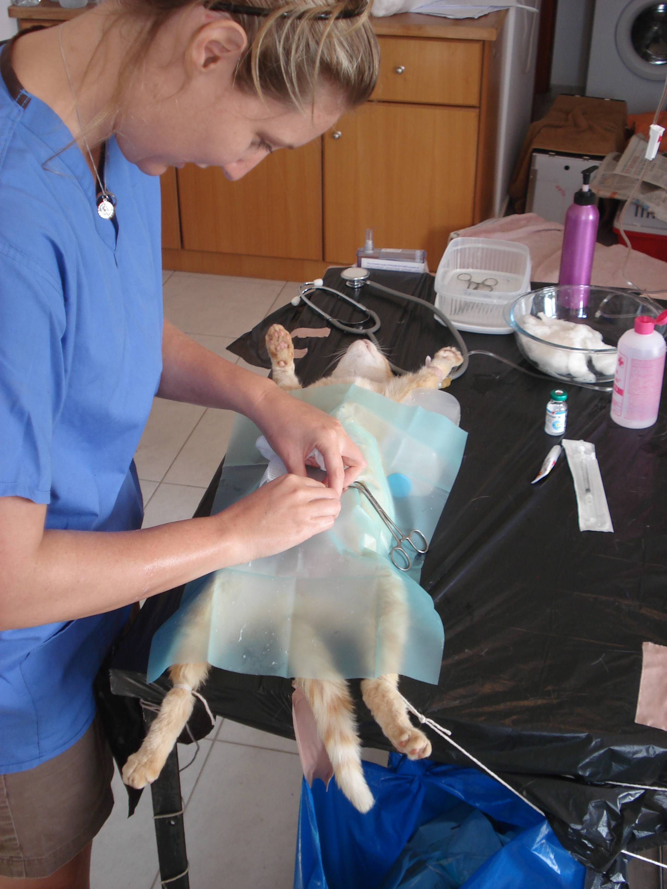
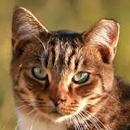
What are the local barriers?

Slide 3
Population Control
Owners
Vet Authority
NGOs
Government Agencies
Local Authorites
Private sector vets
Notes:
The Veterinary Authority is responsible for the implementation of animal health and animal welfare legislation
Control of stray dogs with regard to other human health risks (e.g. stray dogs on roads; dog attacks within communities) may fall within the responsibility of the public health agency but is more likely to be the responsibility of the local government authorities or other agencies for public safety/security operating at the state/provincial or municipal level
The private veterinarian has competence and will normally be involved in dog health programmes and population control measures
Non-governmental organisations (NGOs) are potentially important partners of the Veterinary Services in contributing to public awareness and understanding and helping to obtain resources to contribute in a practical way to the design and successful implementation of dog control programmes. NGOs can supply local knowledge on dog populations and features of ownership, as well as expertise in handling and kennelling dogs and the implementation of sterilisation programmes.
In many countries local government agencies are responsible for the development and enforcement of legislation relating to dog ownership (e.g. registration, microchipping, vaccination, leash laws, abandonment), the control of stray dogs (e.g. dog catching and shelters) and the alleviation of the problems stray dogs cause in their jurisdiction. This would normally be done with advice from a higher level (national or state/provincial) authority with specialised

Slide 4
ORCA – Western Balkans
https://www.eurogroupforanimals.org/orca-new-dog-population-control-programme-for-western-balkans
Notes:
The results revealed three categories of stray dogs: freely roaming owned dogs; unowned community dogs whose movement is tied to food, water, shelter and care of the people in community and feral dogs who avoid contact with humans and are self-reliant in relation to water, food and shelter
For example, in response to the identified stray dogs categories, the experts concluded that controlling the population of each of the category requires prioritising different measures. For free roaming owned dogs identification and registration is very important, but for other two categories of dogs, sterilisation is of much higher priority.

Slide 5
ICAM Dog Population Management

Slide 7
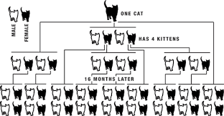
Why Neutering?
One entire female can be responsible for the production of over 20,000 kittens in 5 years
Notes:
Major cat welfare problem is overpopulation and unwanted cats
Neutering is currently seen as the only humane way to control feline populations
At least 75% of the feline population needs to be neutered to control numbers
Traditionally in many countries this is done when a cat is 6 months of age

Slide 8
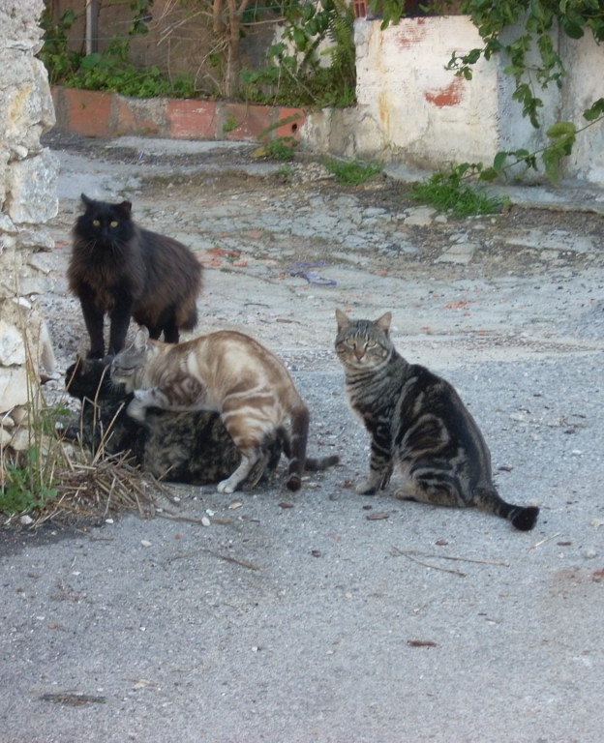
They’re quite good at breeding….

Slide 9
Population Level Reasons
Population control
Maintains stable populations and colonies
Fewer animals die

Slide 10
Individual Animal Reasons
Healthier Individuals
Stress and risk on queens/bitches from pregnancy
Reduces sexual behaviours; territorial fighting, spraying, noise, wandering
Reduces risk of some diseases (FIV and injuries due to fighting)
Reduces mammary, uterine and testicular cancers

Slide 11
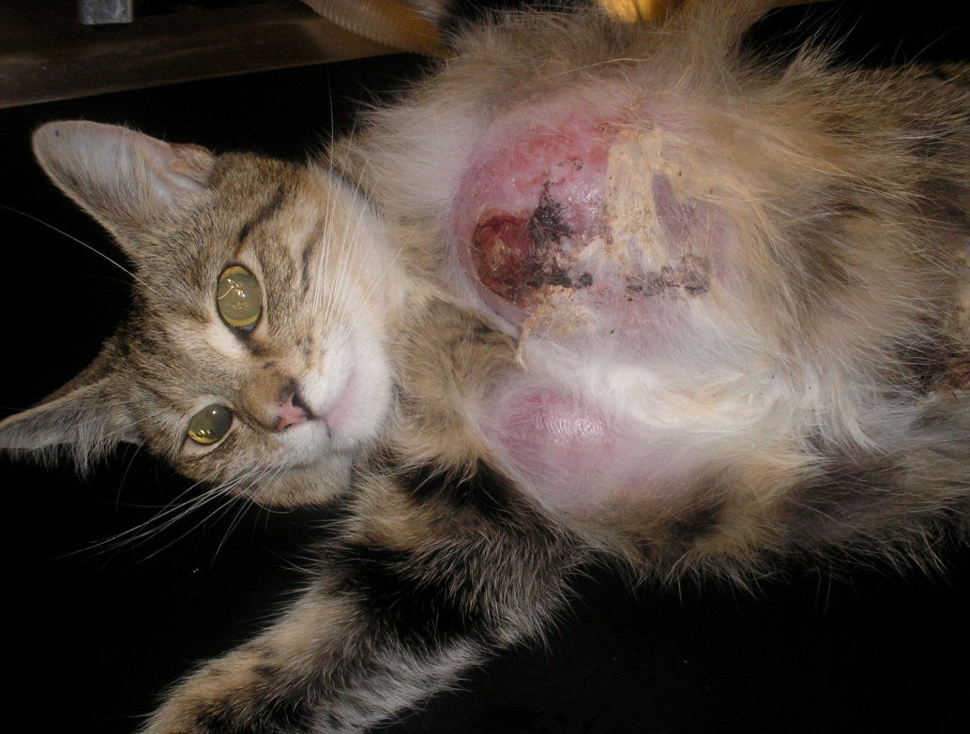
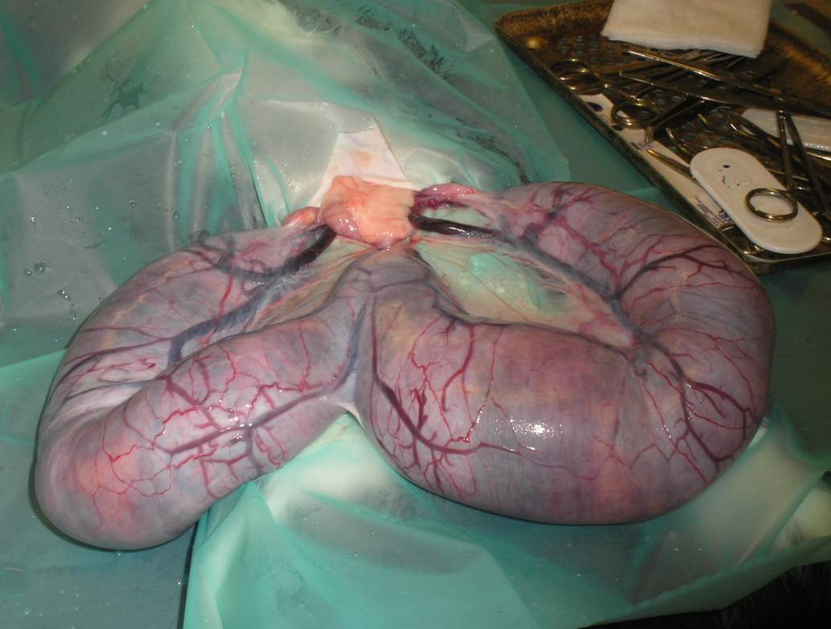
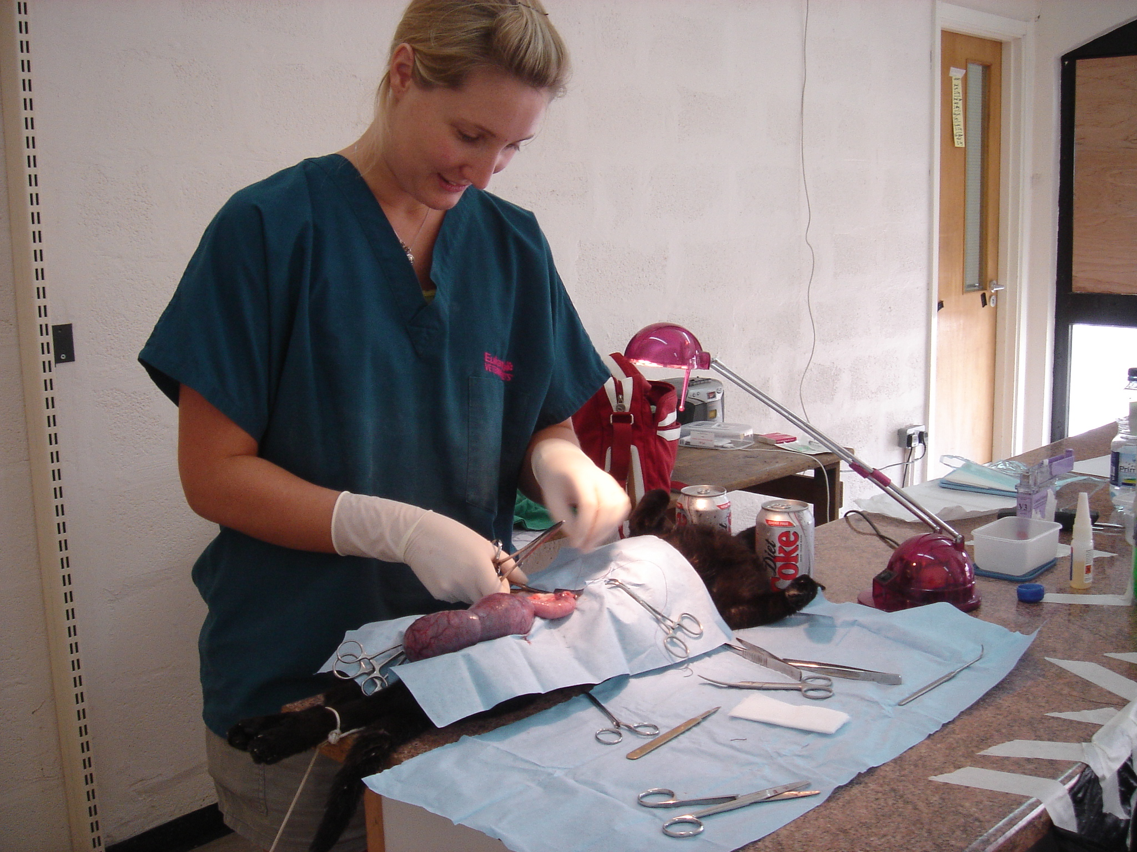
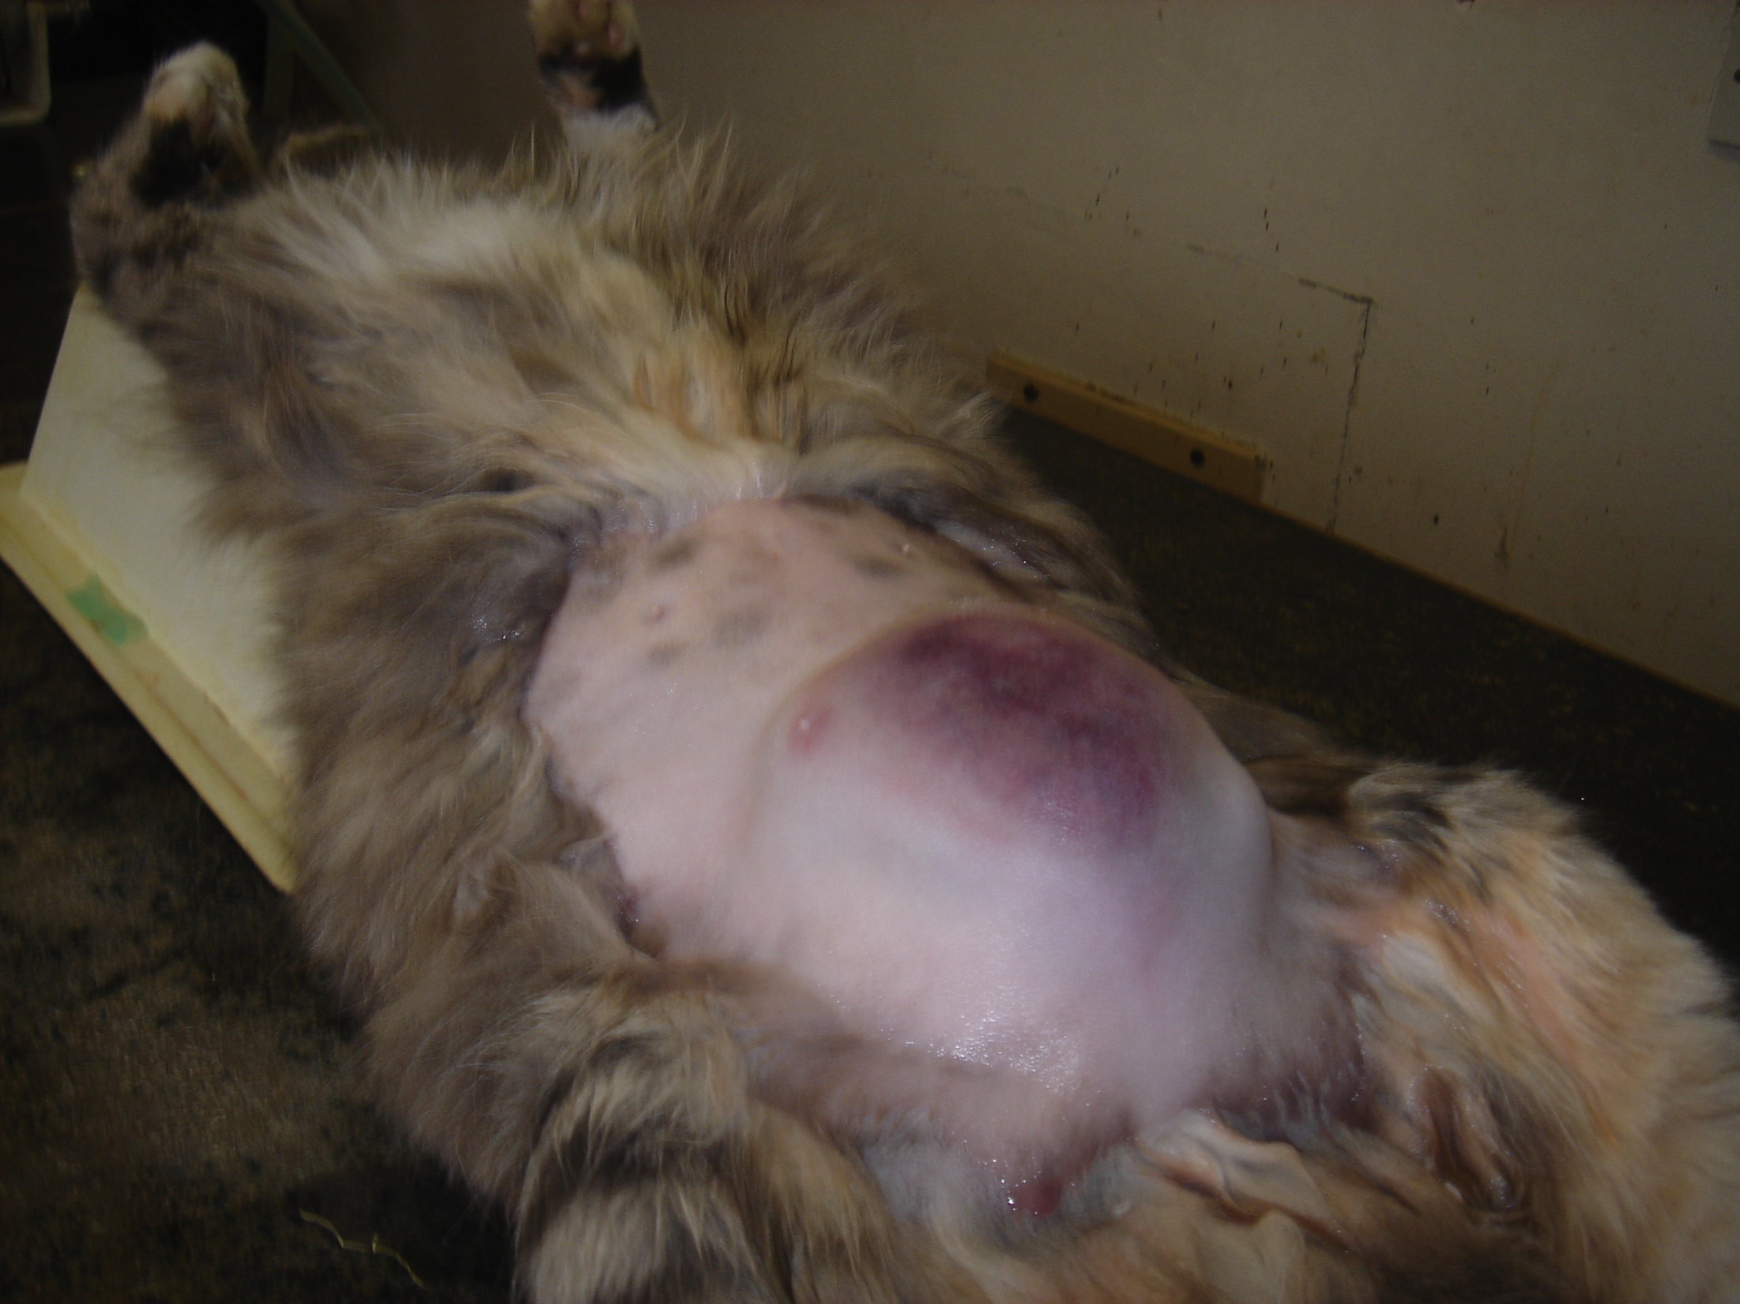

Slide 12
Human Welfare Reasons
Rabies
Perceived nuisance
Dog bites
Possible increased bond
Notes:
Problems caused by dogs, such as noise, faecal pollution, bite injuries and traffic accidents

Slide 13
Neutering Toolbox
Routine neutering of owned animals
Neutering of all animals before rehoming/adoption
Trap, neuter, return
Pre-pubertal neutering

Slide 14
Routine Neutering
Education
Veterinary support
Even when ‘routine’ there are still problems:
Survey of owners in the UK
cats older than 6 months - 92% neutered
19% of female cats had one or more litters
70.5% unplanned

Slide 15
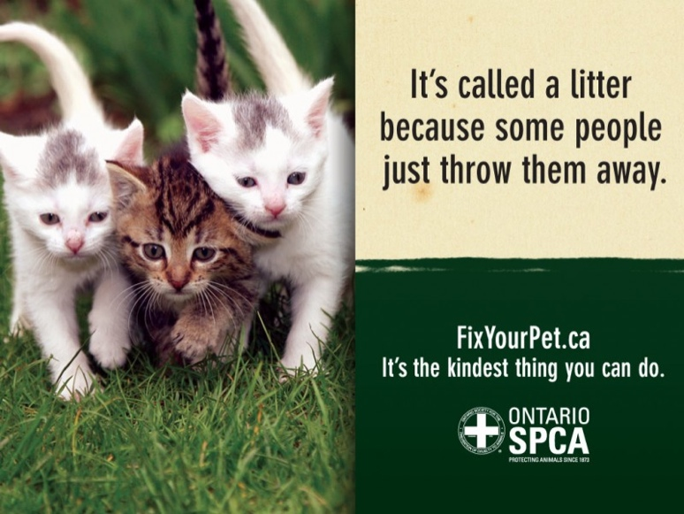
Public education

Slide 16
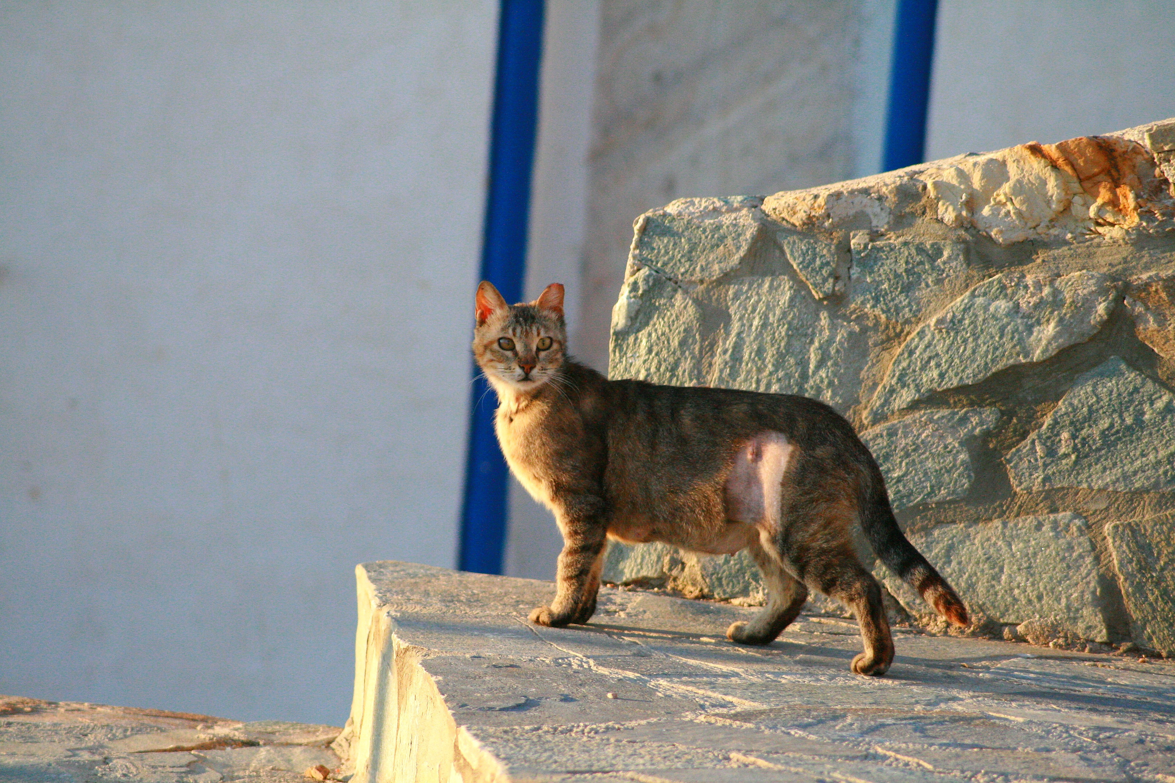
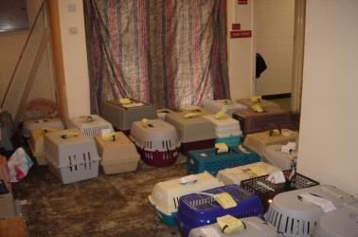
TNR
Notes:
c) If this method is adopted, the following factors should be addressed:
i) raising awareness of the programme within the local community to ensure understanding and support;
ii) use of humane methods for catching, transporting and holding dogs;
iii) correct surgical technique, anaesthesia and analgesia, followed by post-operative care;
iv) disease control may include blanket vaccination (e.g. rabies) and treatments and testing for diseases (e.g. leishmaniasis) followed, as appropriate by treatment or euthanasia of the dog;
v) behavioural observation may be used to assess if dogs are suitable for release; if not suitable for release or rehoming, euthanasia should be considered;
vi) permanent marking (e.g. tattoo or microchip) to indicate that the animal has been sterilised; individual identification also allows for tracking of vaccination status and treatment history and identification of a level of ‘ownership’ by the organisation/authority responsible for carrying out this intervention; a visible identification (e.g. collar) may also be used to prevent unnecessary recapture;
vii) the dog should be returned to a place that is as near as possible to the place of capture;
viii) the welfare of dogs after release should be monitored and action taken if required.

Slide 17
Why return?

Slide 18
A cat is not a cat is not a cat…….

Slide 19
TNR campaigns
Numbers – 85% or 40% every 6 months (ACCAD model)
Community Engagement - owners, neighbours, security
Local authority approval
Vets – local or overseas?
Equipment – traps, nets, crush cages, drugs, recovery areas, lights, disposal facilities, heating!
Acclimatise to traps
Work with feeders & trap at the best time of day
Assume more animals than you think
Reduce stress during capture – trapping techniques, handling, transport
Notes:
Visit the colonies at opposite times of day – both the feeding time and as opposite as possible
Count number of cats seen at both times
Visit any colony sites adjacent where there should be a colony but you can’t see any cats. Estimate the number of cats that you think should be there. Add that to the total
Multiply total x 1.4

Slide 20
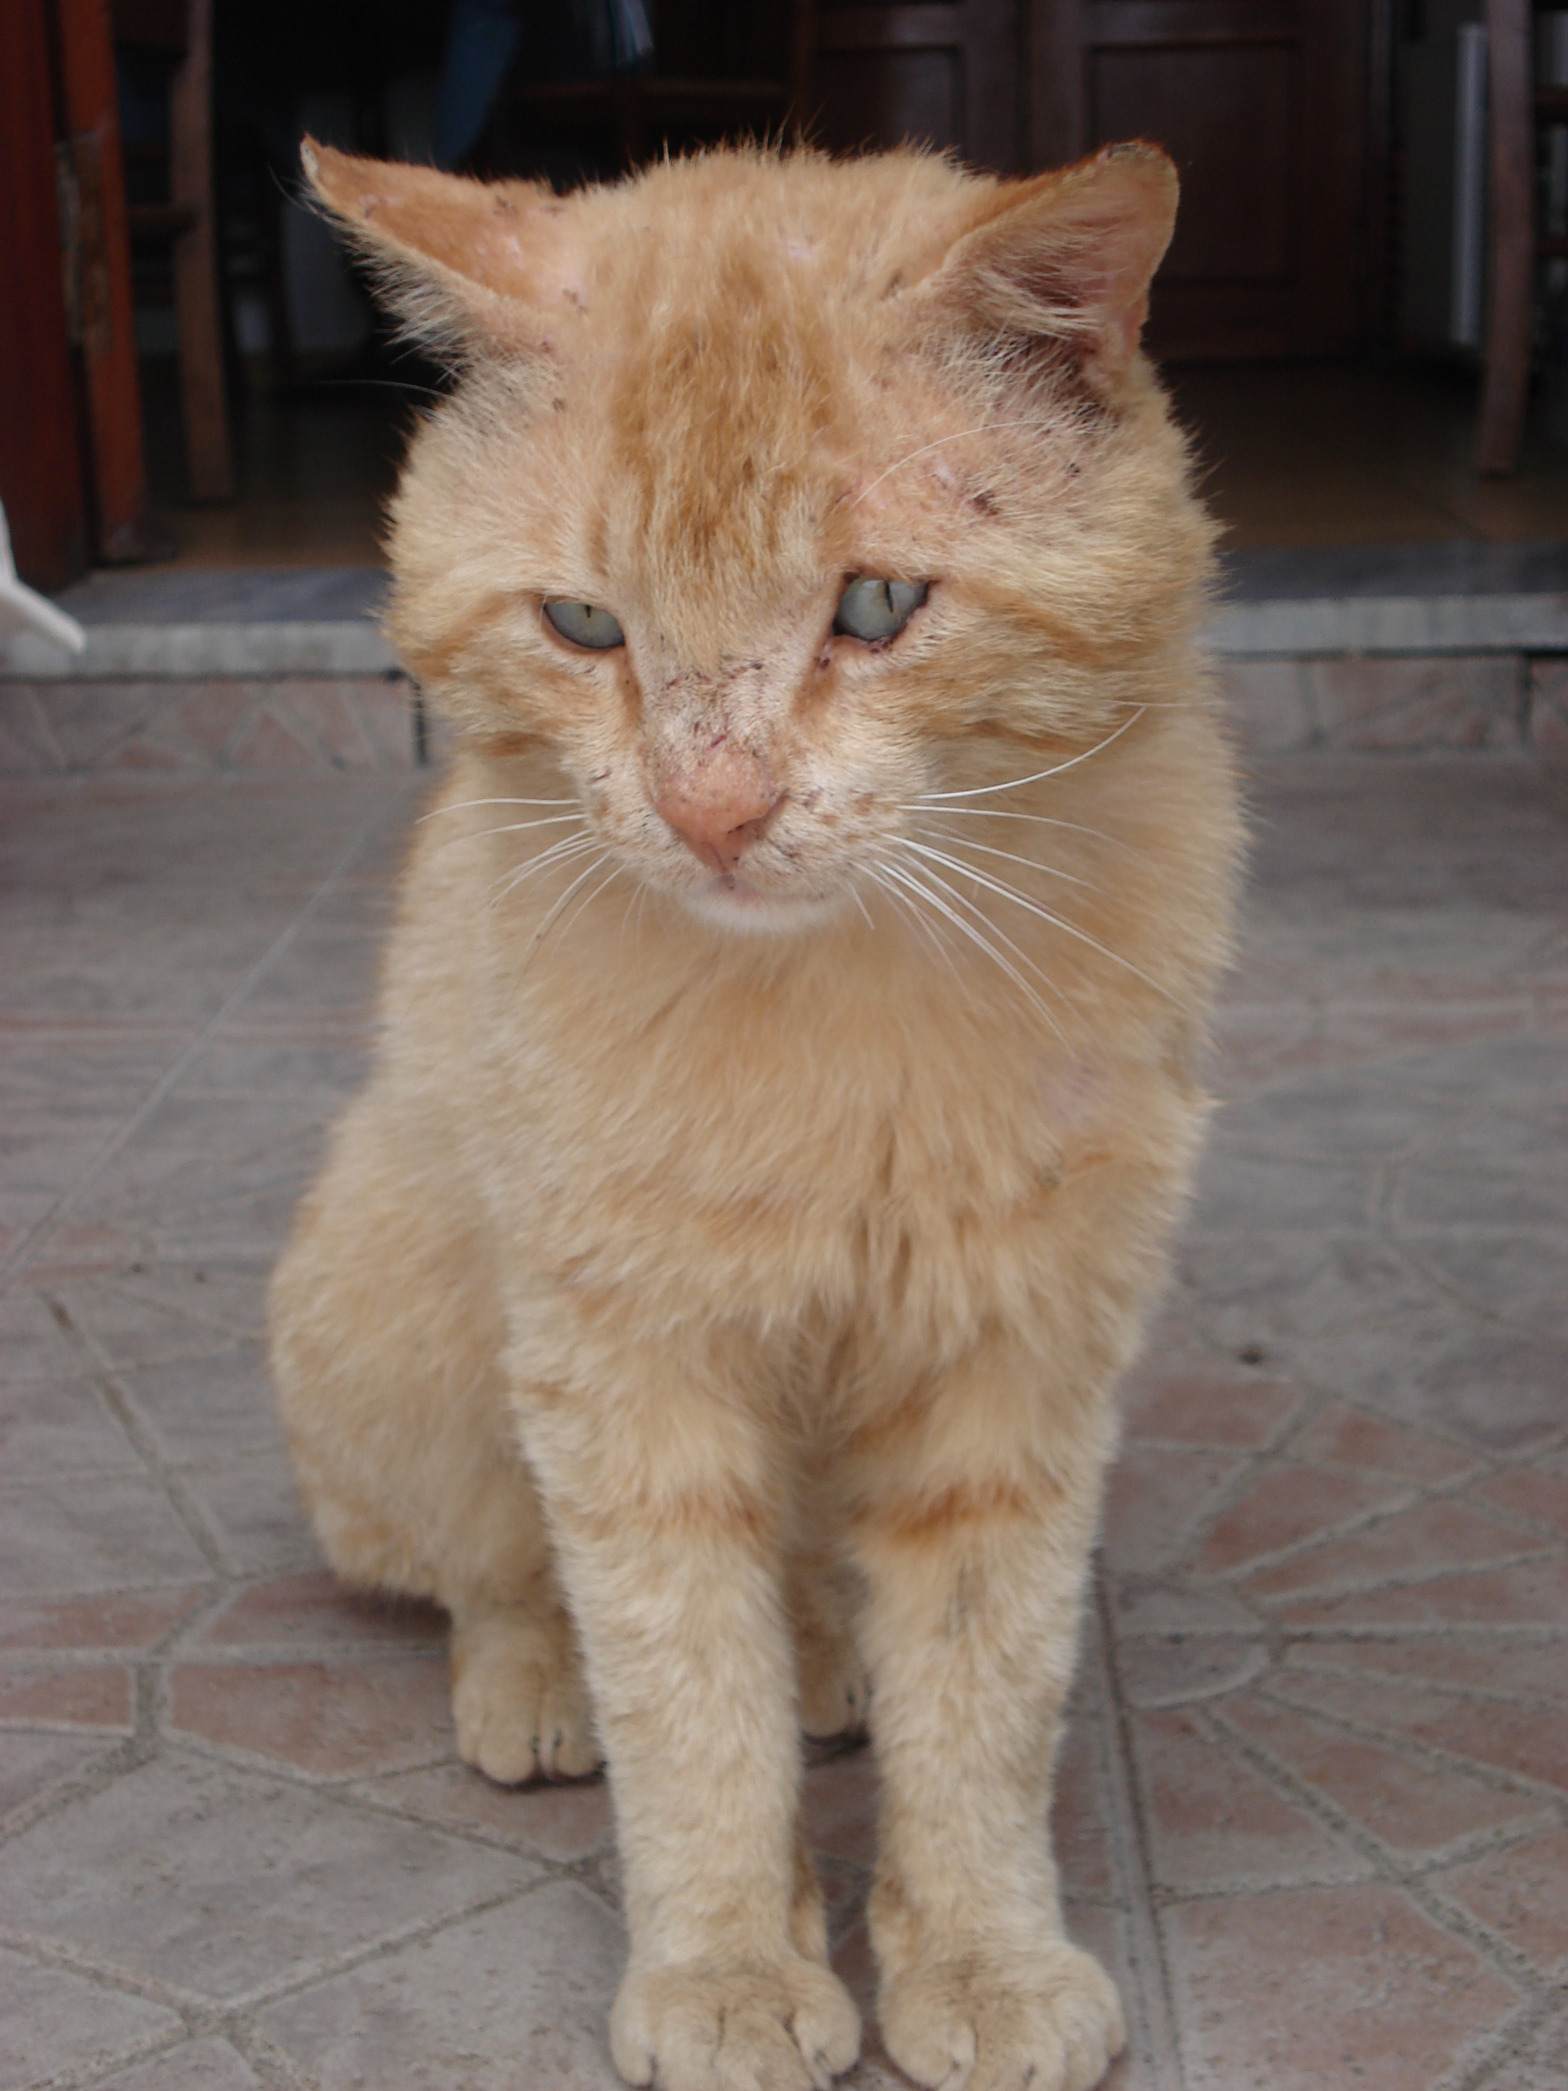
Protocols – before you start
Euthanasia
Treatments – injury/illness
Pregnant animals
Preventative health care – Vac, testing, parasites
Age – how low will you go?
Permanent marking – tipping, tattoo etc.

Slide 21
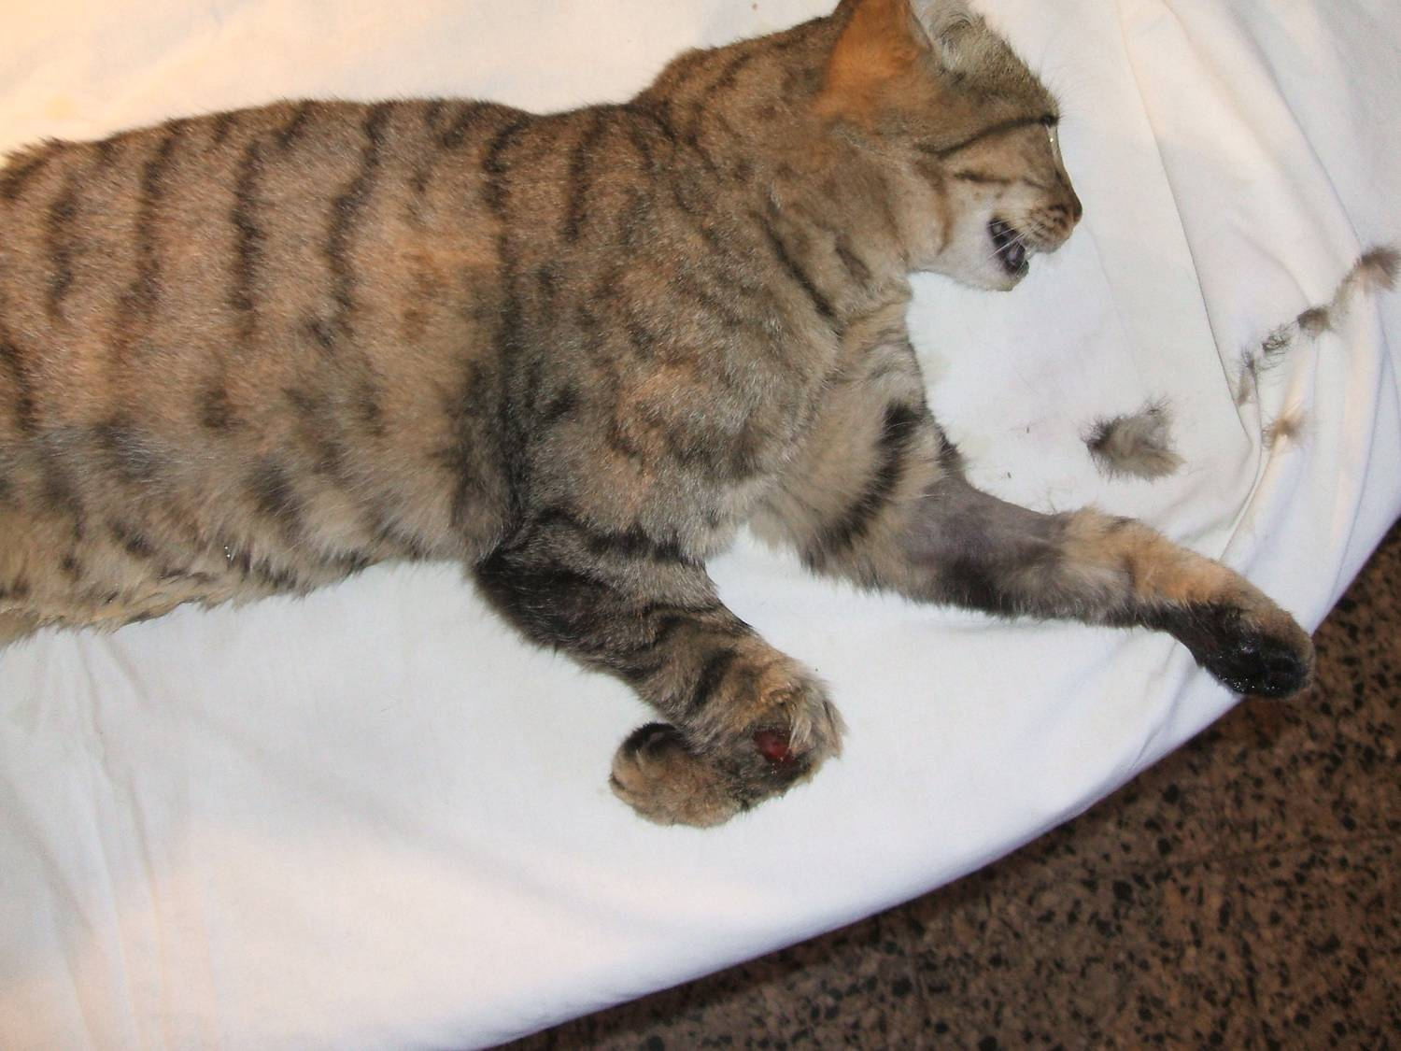
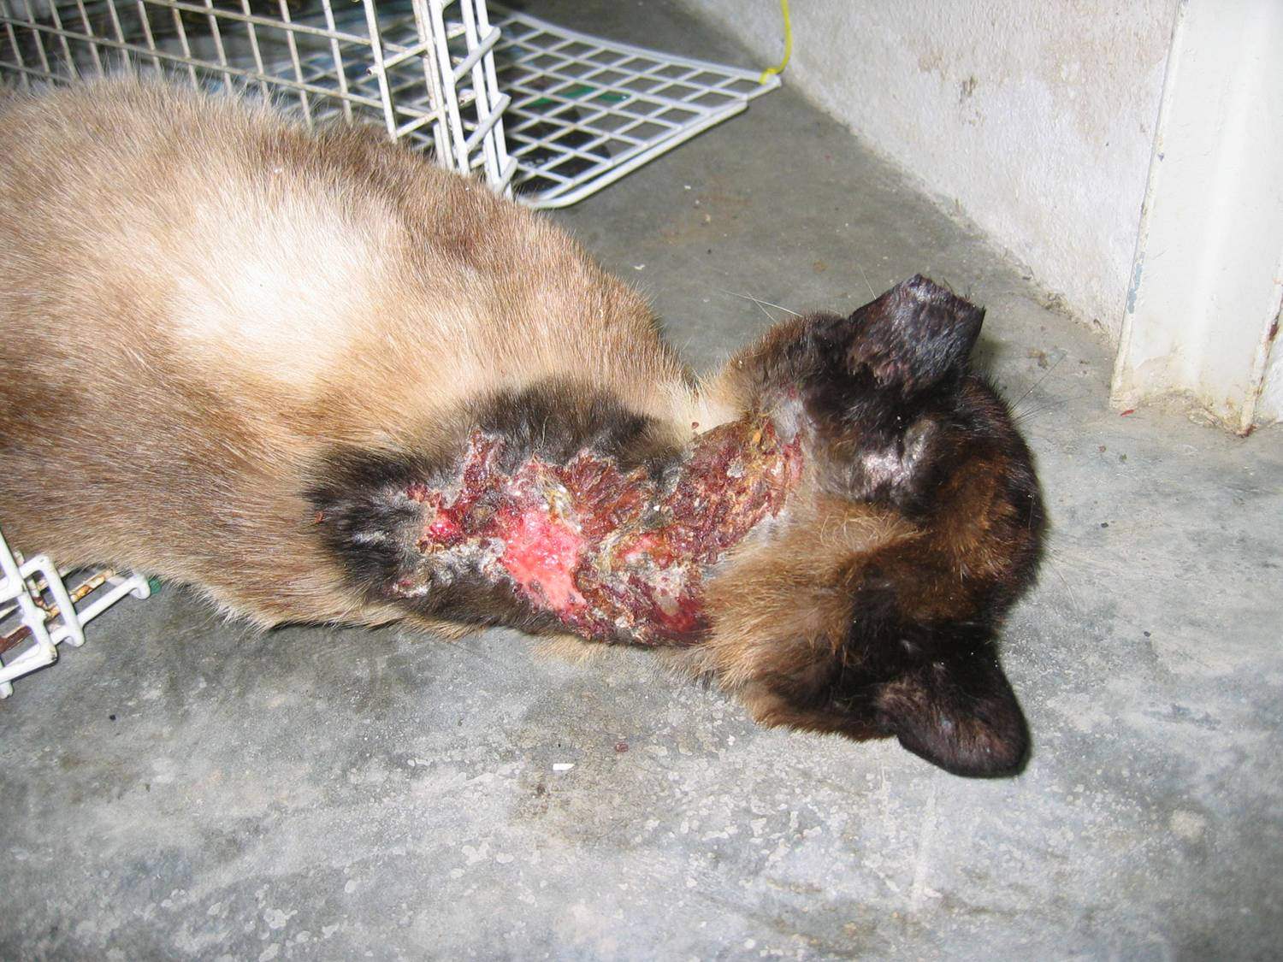
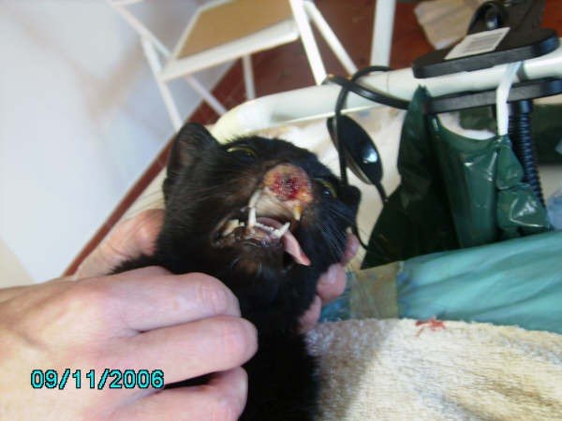
Treat ‘em or street ‘em?
What is the welfare outcome for the animal?
What does the vet say?
How long is too long for recovery to keep in captivity to recover?

Slide 22
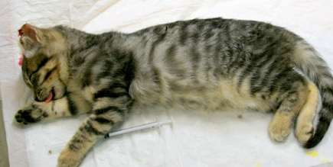
Age of Neutering
Owned – before sexual maturity (cats yes, dogs debatable)
Un-owned – do EVERYTHING
If adopted – there will always be owners that don’t come back
TNR – you won’t get a second chance

Slide 23
Advantages of neutering younger animals
Neutered prior to rehoming
Good when poor owner compliance
Reduces population faster
Avoids the need to recapture
Can do whole litters
Reduce stress

Slide 24
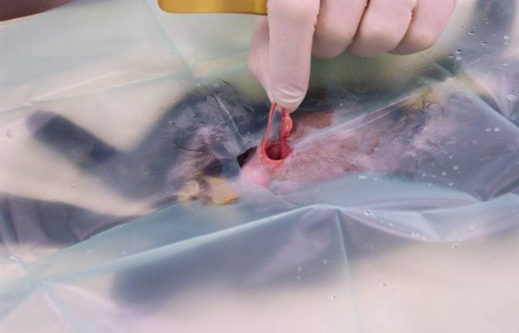
Vetty reasons to neuter younger….
Faster
Easier
Not pregnant or on heat
Each surgery the same
Tiny wounds – quick healing
Don’t bleed much
NO FAT!!!!!
Cheaper (less drugs)
FAST recovery
No pyometras, mammary tumours, mammary hyperplasia

Slide 25
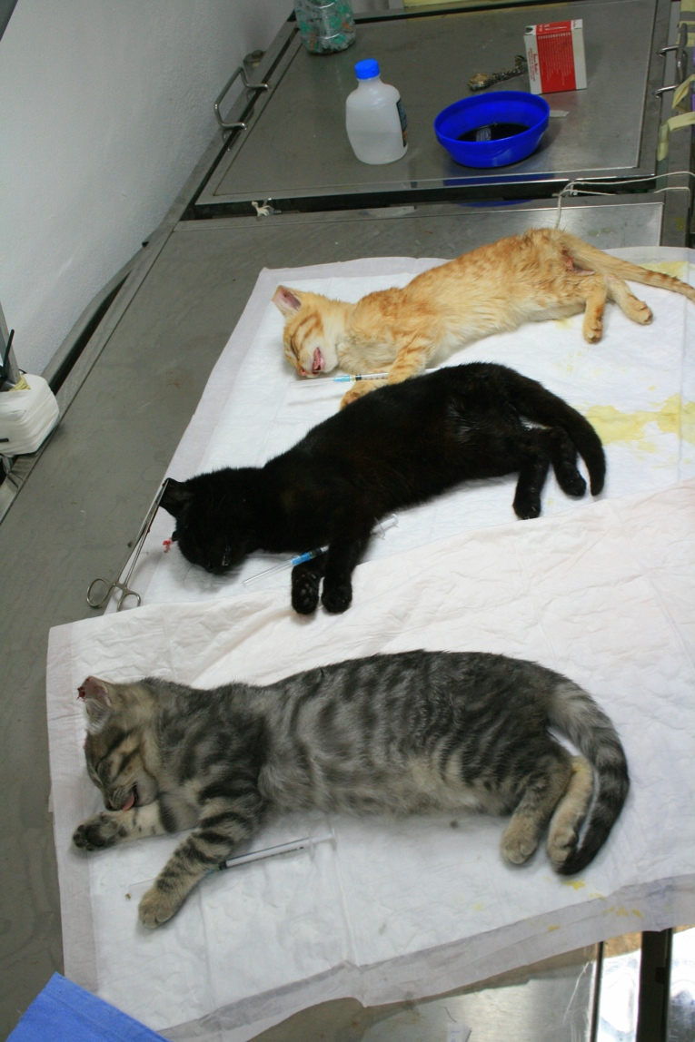
But wait – isn’t it risky?
What do you think the risks might be?
Notes:
Anaesthetics
surgical complication - tricky
too small
FLUTD
growth plates
obesity

Slide 26
But wait – isn’t it risky?
What do you think the risks might be?
‘They’re just babies’
‘Surgery/anesthetic is too risky’
‘It’ll stunt their growth’
Notes:
Anaesthetics
surgical complication - tricky
too small
FLUTD
growth plates
obesity
Anesthetics are safe
Procedure is quicker – no fat
Recovery is faster
Pain relief can and should be given regardless of licensing
Urethral diameter, bone growth
No benefit to having a heat and certainly not a litter
Traditional neutering age has no evidence

Slide 27
Feline Pre-pubertal neutering - evidence
No evidence of developmental or behavioural probs.
New drugs mean GA risk limited
Surgery risk – safest surgery is one you’re familiar with
Growth plates
Urethral diameter

Slide 28
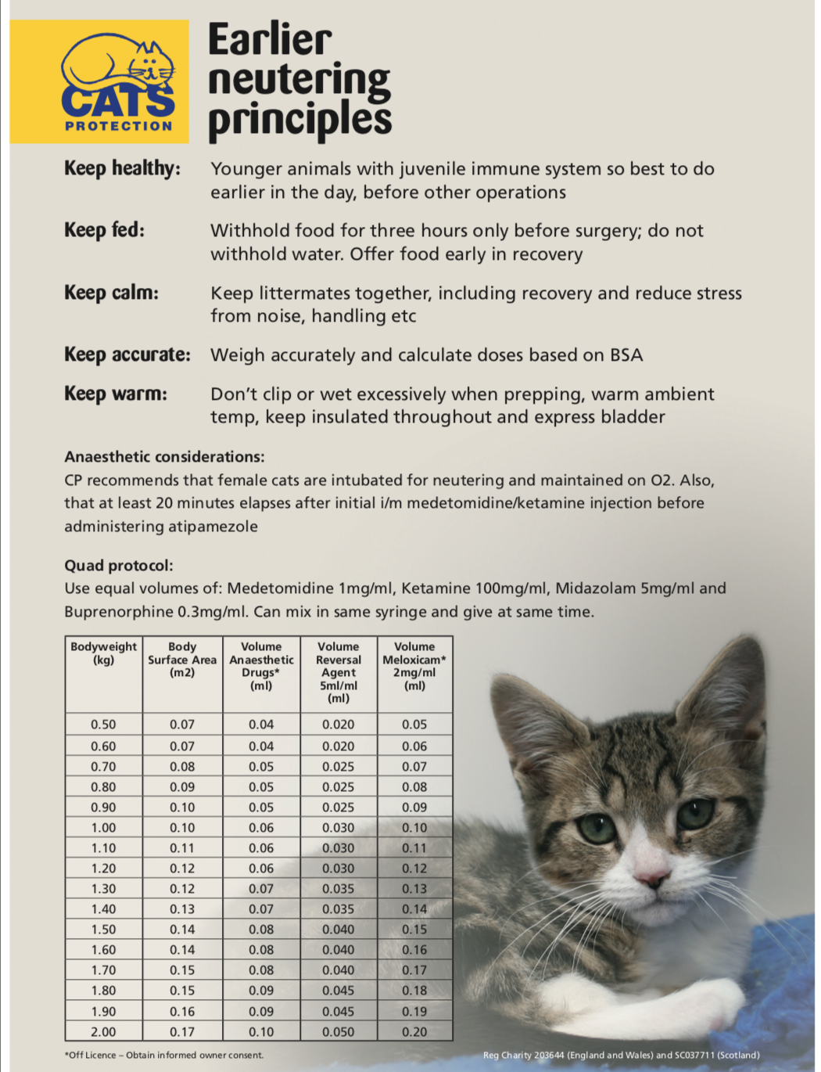
Anaesthetics
Notes:
Dom, Torb, Ket and for bonus points, Midazolam
I/M
Reversable
Combos good to reduce side effects
Go to sleep quick
Wake up real quick
Easy dosing
Body surface area
Joys of Midazolam

Slide 29
Tips
Surgical
Clip small and keep dry
Flank or midline ok
Clear abdo fluid normal!
Tissues hardier than you think
Incision further caudal than normal
Testicles ARE there – but mobile
General
Keep warm
Keep fed
Do first
Weigh accurately
Low stress – socialization

Slide 30
Useful resource
https://www.cats.org.uk/help-and-advice/information-for-vets/early-kitten-neutering-vets

Slide 31
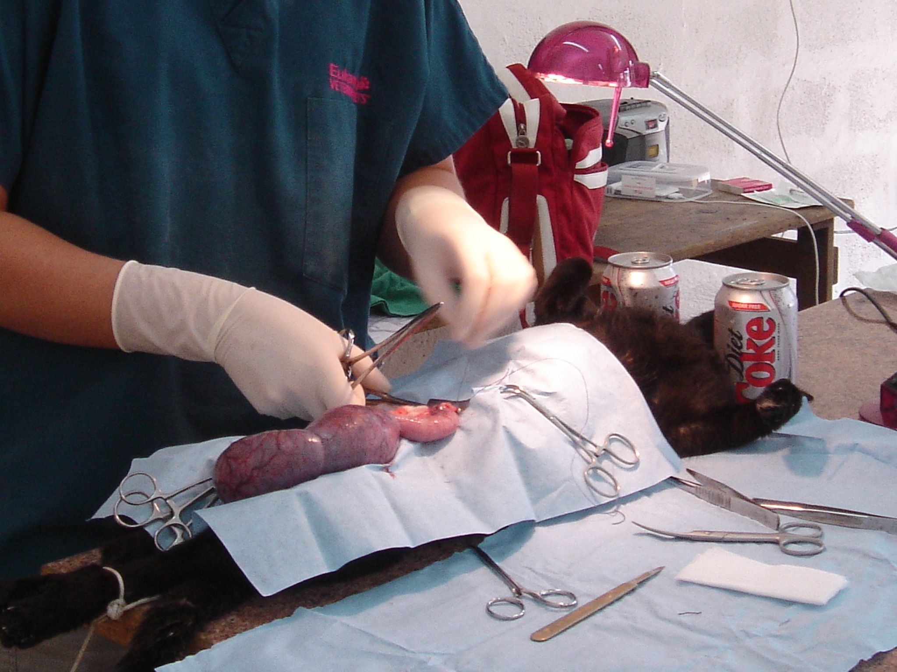
Pregnant Spays
‘It’s abortion’
‘It’s too risky for the mum’
‘The kittens should have a chance at life’
‘The mum cat will grieve’
‘Every cat should have a litter’
‘But we can home the kittens!’
‘It’s ok early on, but not late’

Slide 32
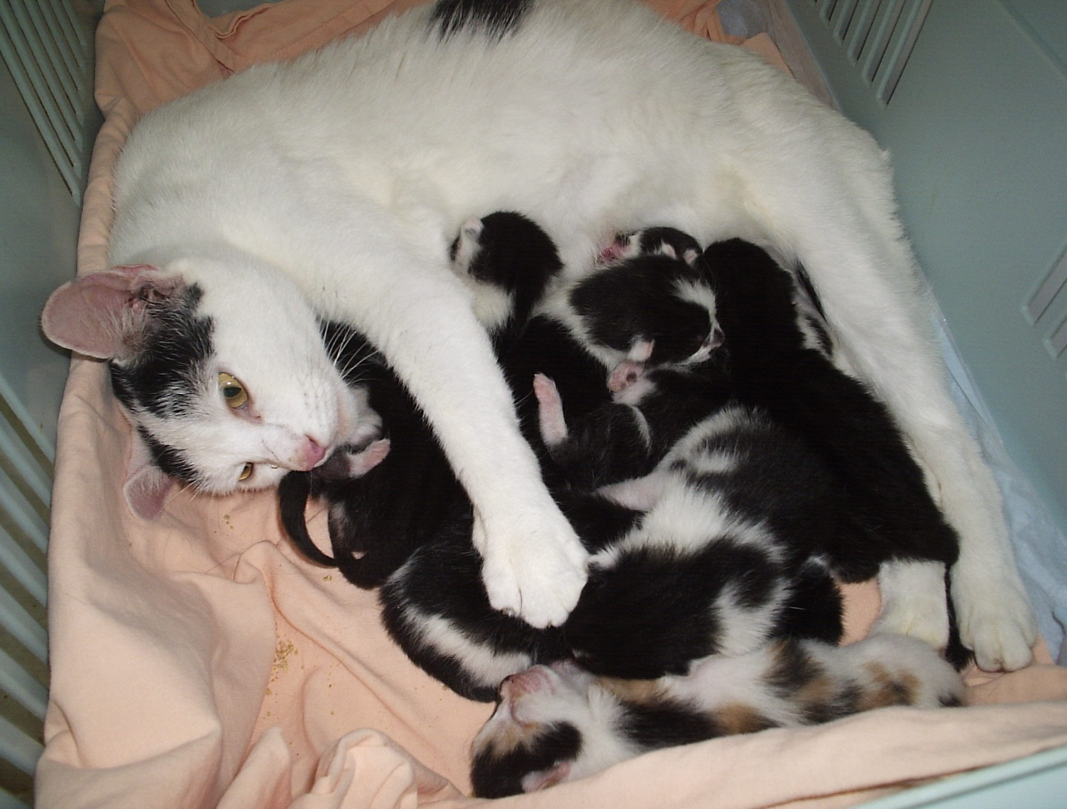
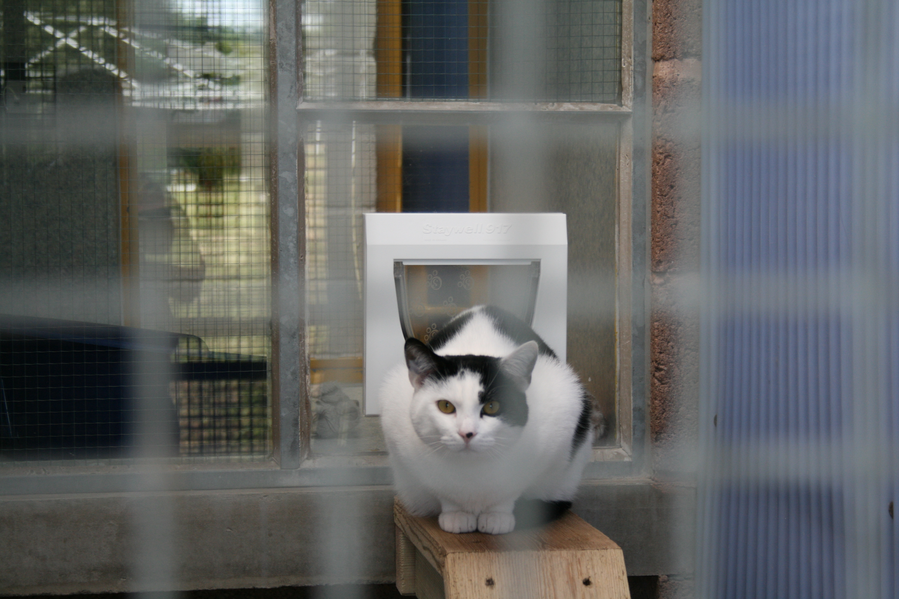
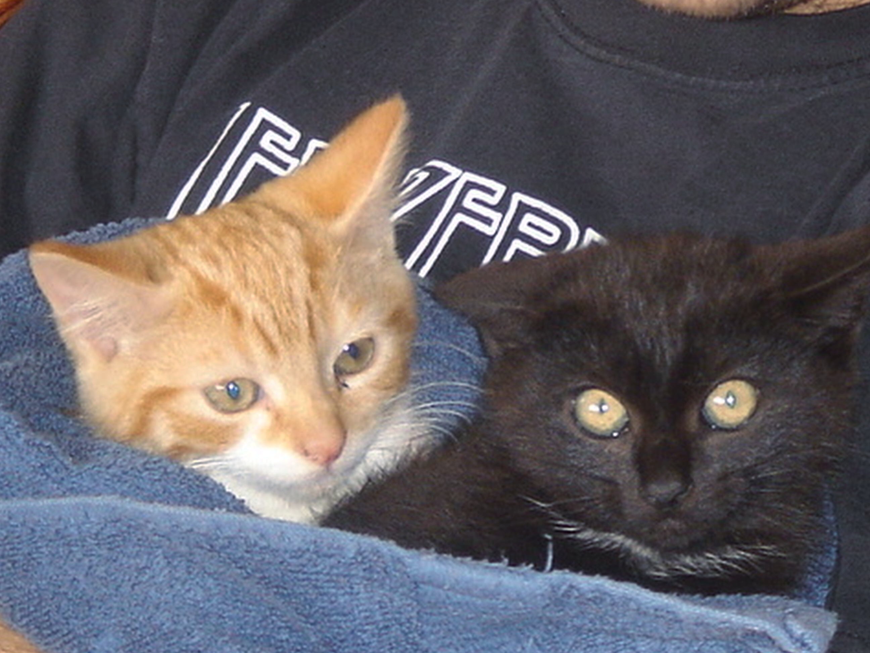
Evidence
What actually happens during a pregnant spay?
Surgical risks to mum
Kitten and puppy welfare if born
Mum welfare if born
Population view

Slide 33
A helpful way to frame the issue
To whom is your moral duty?
The cat in front of you, or the unborn fetuses?

Slide 34
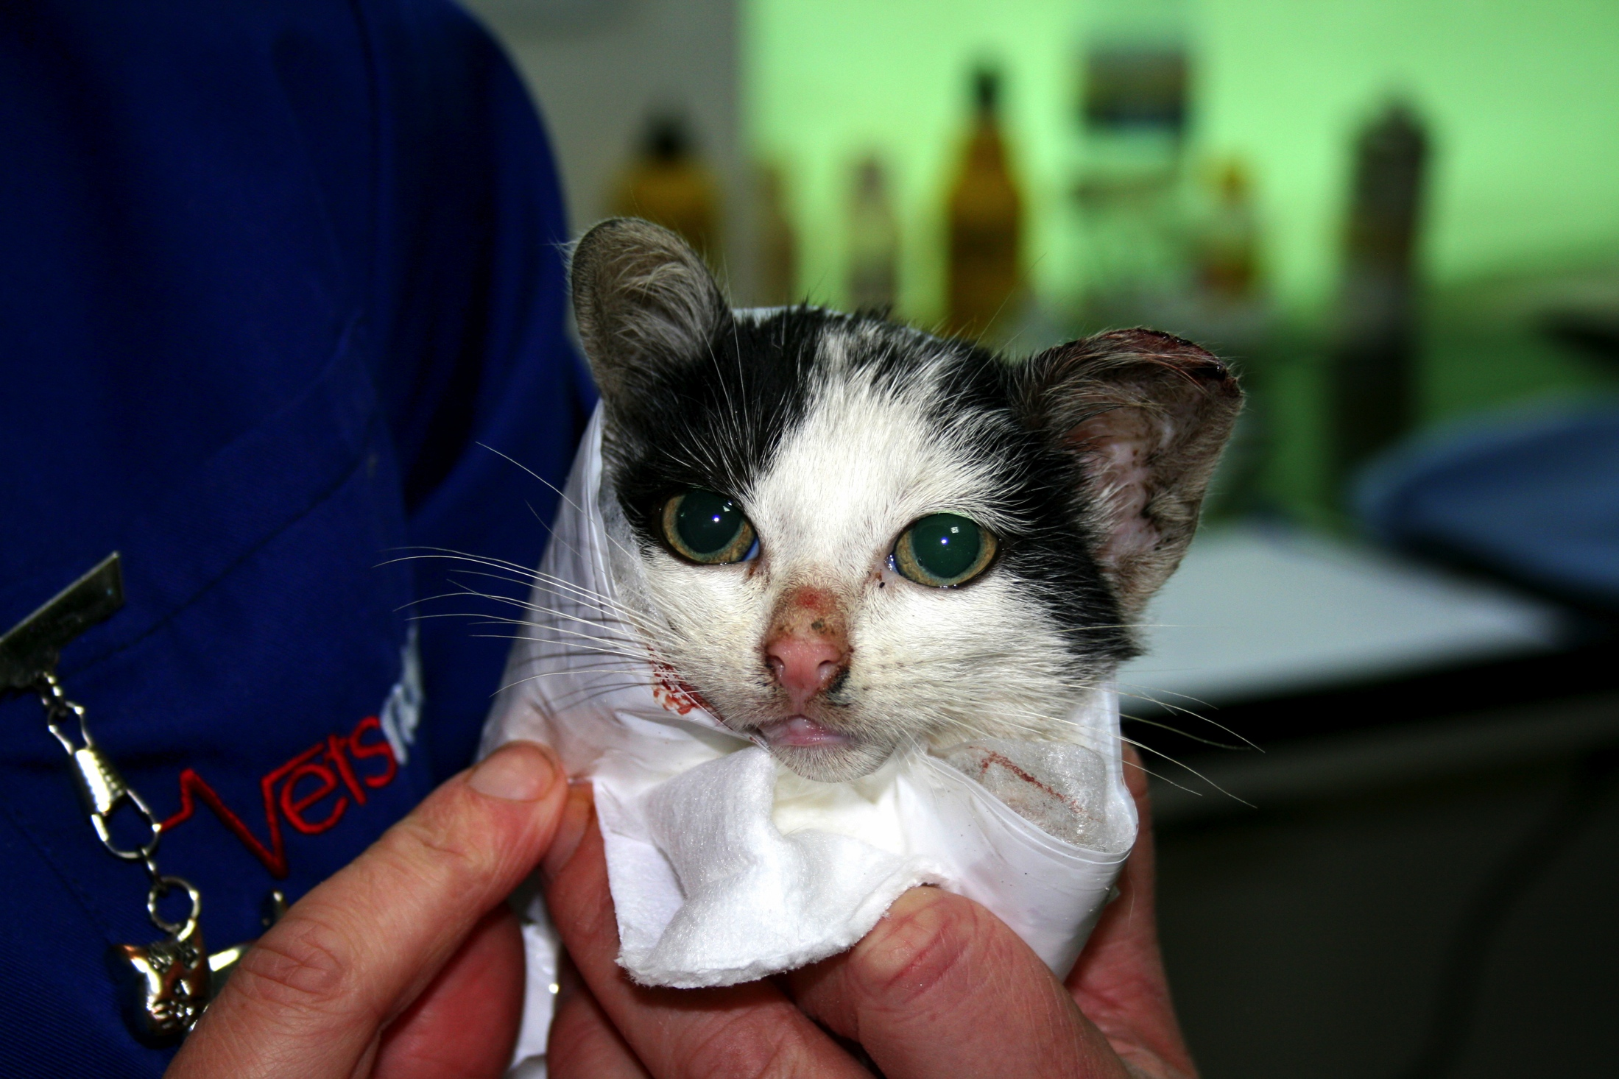
Resources
https://d31j74p4lpxrfp.cloudfront.net/sites/default/files/ca_-_en_files/icam_dog_population_management_tcm22-8291.pdf
Levy et al., 2014. Effect of high-impact targeted trap-neuter-return and adoption of community cats on cat intake to a shelter. The Veterinary Journal, 201:3, 269-274.
Boone et al. 2019. A Long-Term Lens: Cumulative Impacts of Free-Roaming Cat Management Strategy and Intensity on Preventable Cat Mortalities. Frontiers in Veterinary Science, 6, 238.
Humane Cat Population Management Guidance, International Companion Animal Management Coalition, 2011.

