Slide 1
The Trade of Exotic Pets
Dr. Chris Draper
Performing Animal Welfare Society (PAWS)
California, USA

Slide 2
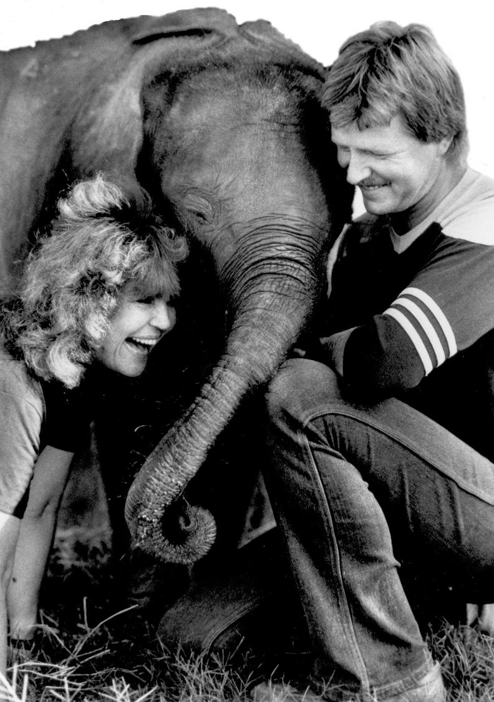

Slide 3
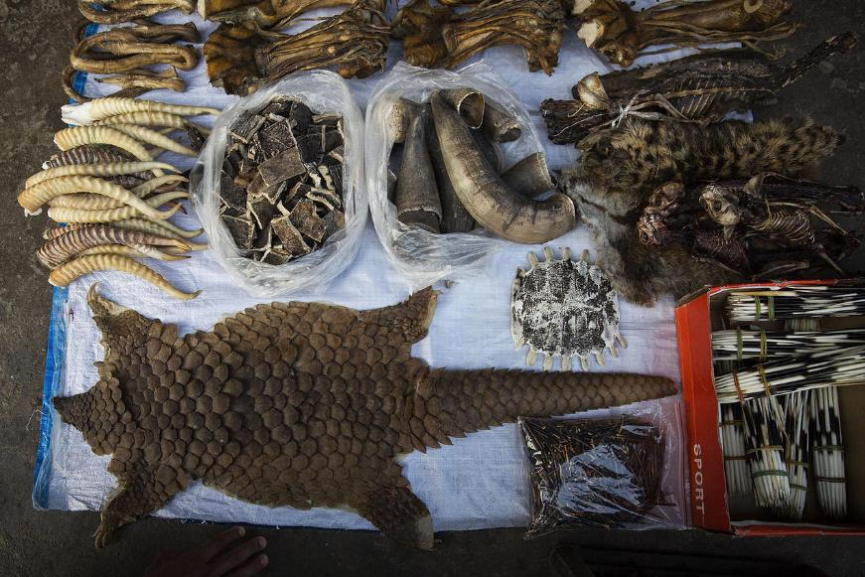
International Wildlife Trade
$100s of billions per year
Growing
Uses:
Food
Medicine
Ornaments
Entertainment
Research
Pets

Slide 4
International Wildlife Trade
Legal trade
CITES
$320 billion
2.2 million reptiles
34,000 mammals
Ensure that trade does not affect survival of species

Slide 5
International Wildlife Trade
Illegal trade
Organised crime and terrorism
$260 billion

Slide 6
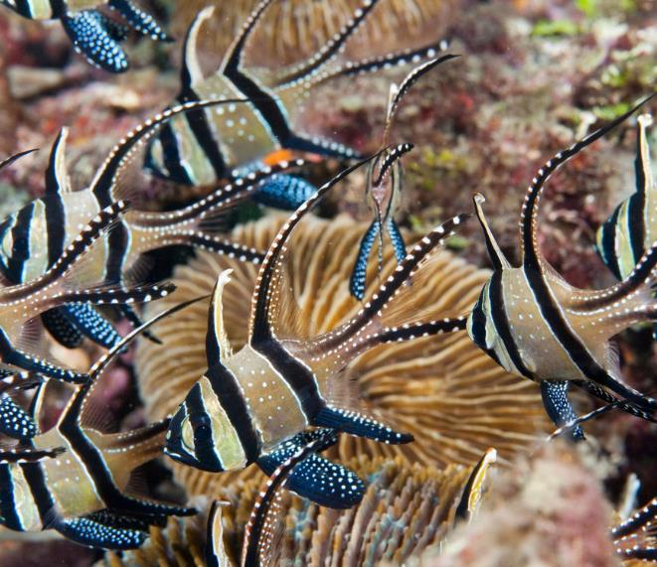
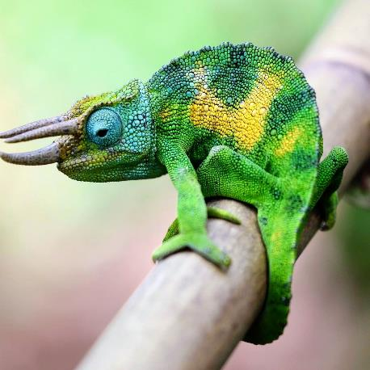
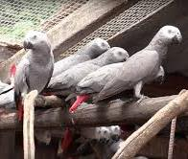
Scale of the Issue
E.g. UK
30-40 million fish
700,000 reptiles
700,000 caged birds
Underestimates?
8m reptiles and amphibians

Slide 7
Scale of the Issue
1,796 adverts of exotics for sale in UK (2017)
53 species of reptile
37 species of bird
28 species of mammal
7 species of amphibian
RSPCA rescues more than >4,000 exotics each year in England and Wales

Slide 8
What is an Exotic Pet?
Domesticated vs. non-domesticated / wild
Captive breeding vs. wild capture
Availability does not equate to ease of keeping
Rarity and novelty are significant drivers of demand

Slide 9
Welfare of Exotic Pets

Slide 10
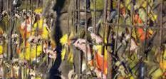
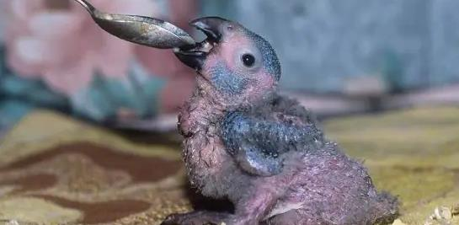
Welfare of Exotic Pets
Need to consider welfare throughout the supply chain:
Capture – including non-target animals
Captive-breeding
Transport
Holding
Point of sale
Life as a pet in a domestic environment
Abandonment and rescue

Slide 11
Welfare of Exotic Pets
Need to consider welfare throughout the supply chain:
Intensity and duration of suffering
Scale of suffering – number of animals experiencing
Mortality
WC reptiles up to 90%
Up to 75% per year when kept as pets
Direct vs indirect impacts
Death
Sublethal effects
Dependent young
Social structure
Culture

Slide 12
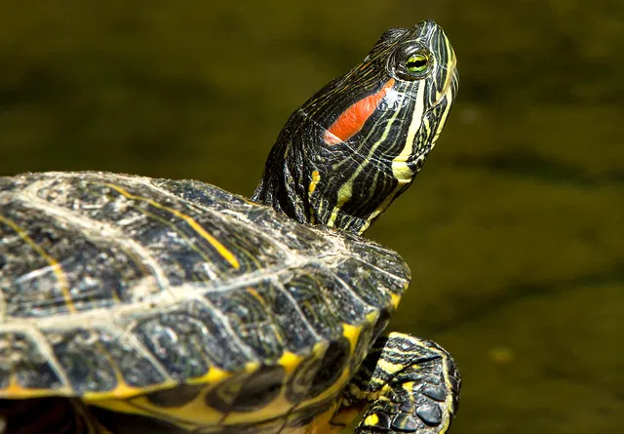
Welfare of Exotic Pets
Knowledge and standards
Wide range of sources of information
E.g. red-eared terrapin water temperature
24 - 27°c
30 - 35°c
23°c
24 - 28°c
Veterinarians

Slide 13
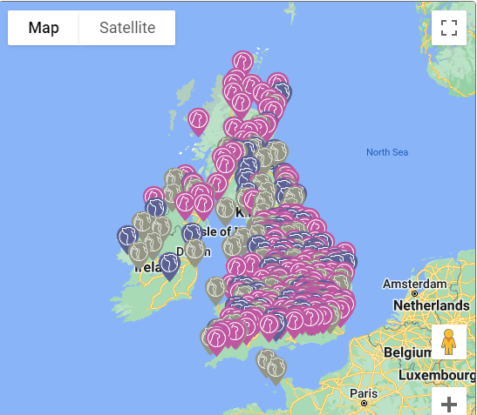
Rescue & Rehoming of Exotic Pets
Large network of shelters / rehoming opportunities for domesticated species
Nothing similar exists for exotic species
E.g. – in the UK:
> 160 members of ADCH
Handful of exotic rescues

Slide 14
Welfare of Exotic Pets
Huge variation:
- in species
in welfare requirements
in knowledge of biology and needs
in available resources

Slide 15
Legislation and Control
CITES?
EU?
National Governments

Slide 16
Legislation and Control
Example:
Dangerous Wild Animals Act 1976 (Great Britain)
Anyone can keep anything – with licence
210 licensees, keeping 3951 dangerous wild animals
Servals
Cat hybrids
Pit vipers
Lemurs
Decreased over time
Association between cost and licensing

Slide 17
Legislation and Control
Risk to public
Risk to owner
Risk to environment
Risk to biodiversity
Risk to animal health
Risk to human health
Risk to animal welfare

Slide 18
Legislation and Control
Positive vs. Negative lists
Negative List | Positive List
A ban on keeping the following species: Tigers (Panthera tigris) Lions (Panthera leo) Rattlesnake (Crotalus atrox) Etc. | The following species are permitted to be kept: Dogs Cats Guinea pigs Etc.

Slide 19
Legislation and Control
Opposition from vested interests
Trade: Dealers, collectors, owners
Others: animal keepers, zoos, veterinarians

Slide 20
THANK YOU
cdraper@pawsweb.org

