Slide 1
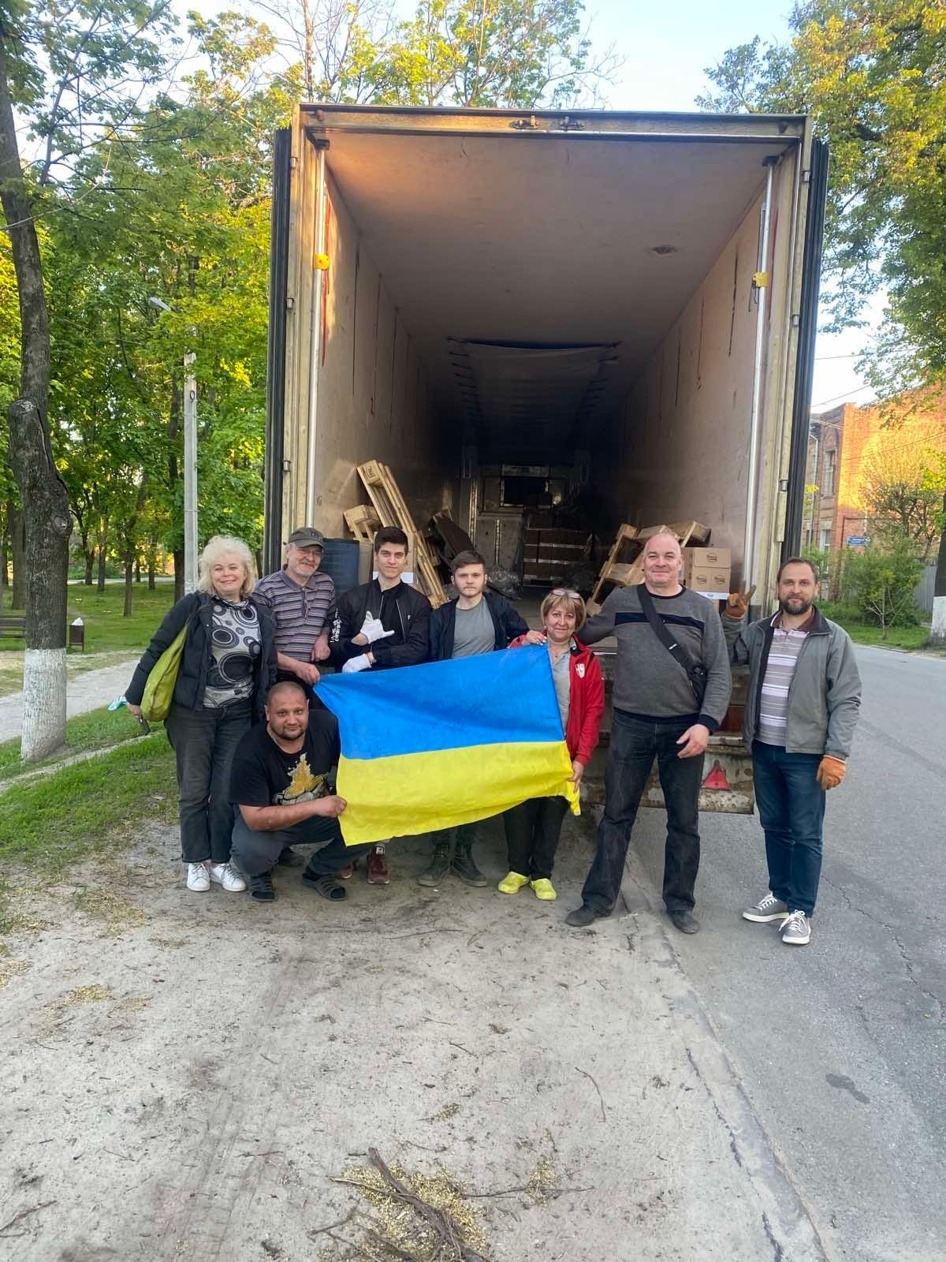
Aid for Ukrainian animals in war
Natalie Sorokopud

Slide 2
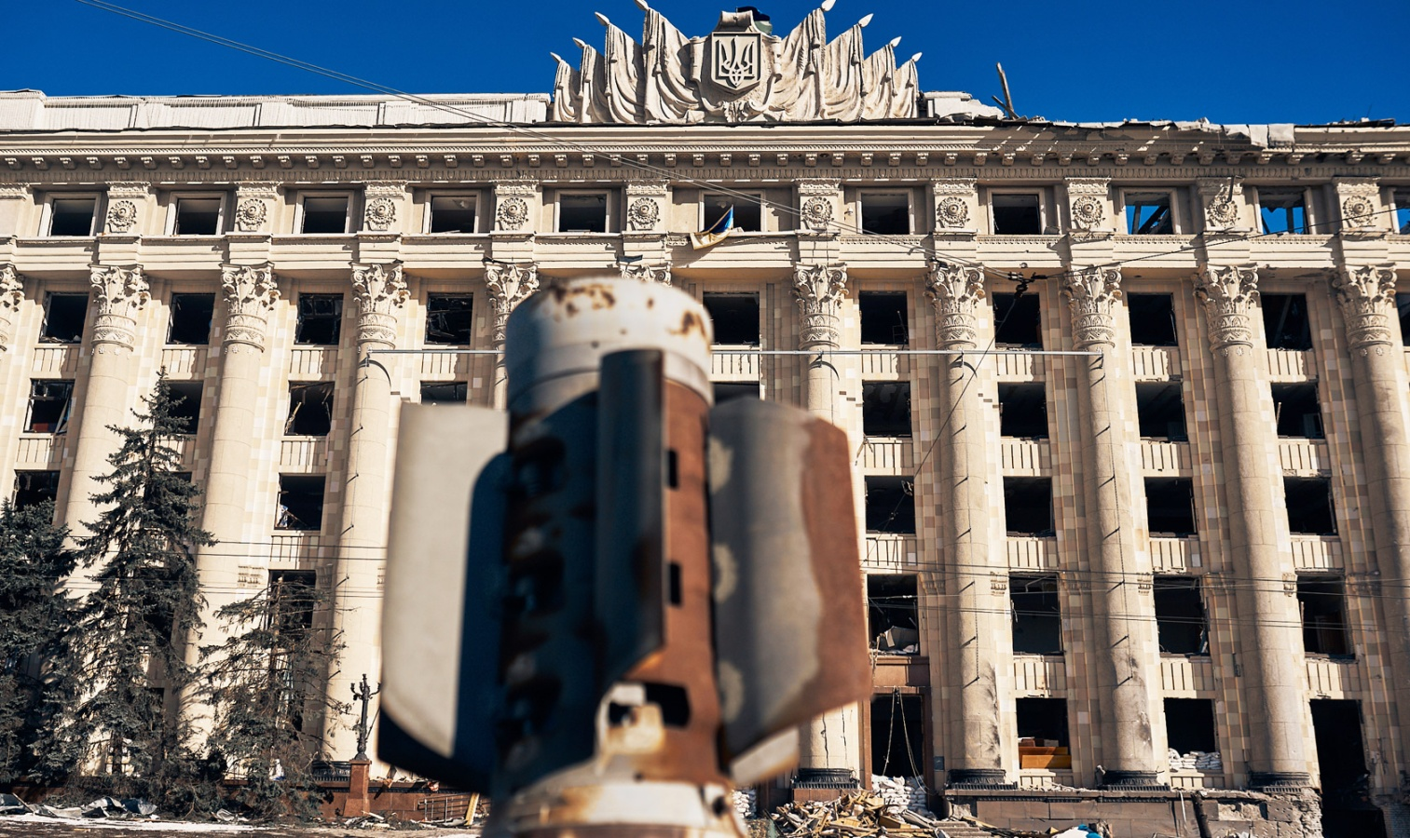
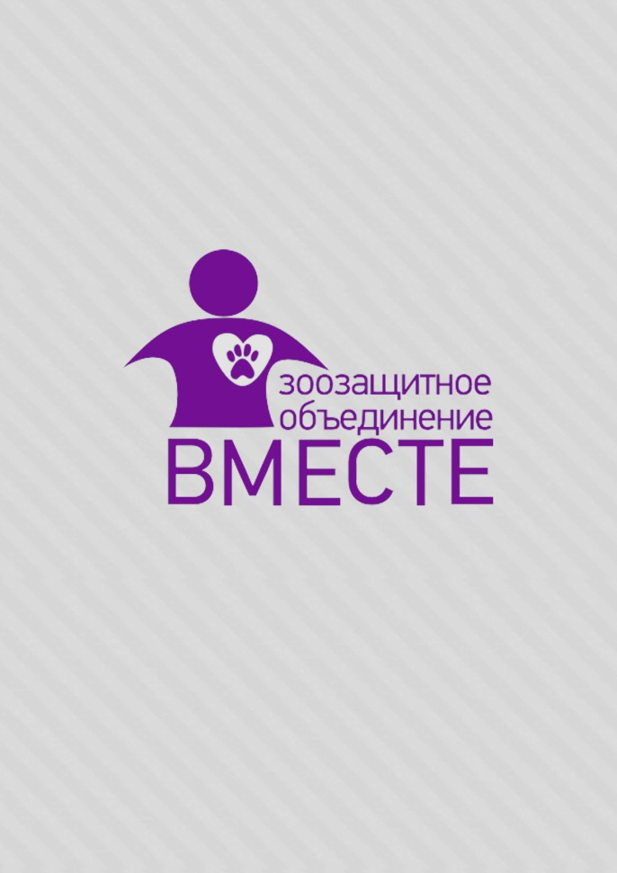
Representative in Ukraine for
Co-founfer of Kharkiv NGO
Volunteer for
Notes:
I'm Natalie, I work for NWF and volunteer for NGOs Together and UPAW. Originally I'm from Kharkiv, the city that is under constant shelling from the first day of Russian war against Ukraine.

Slide 3
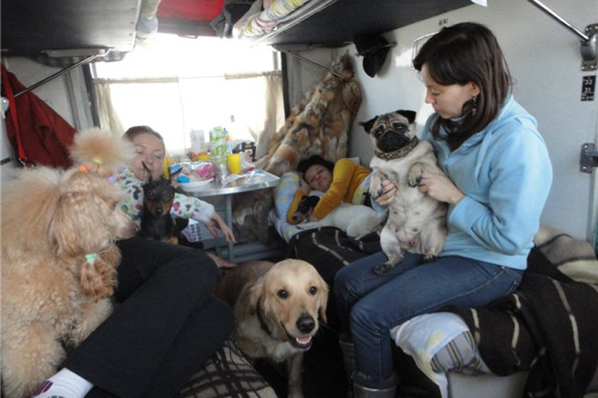
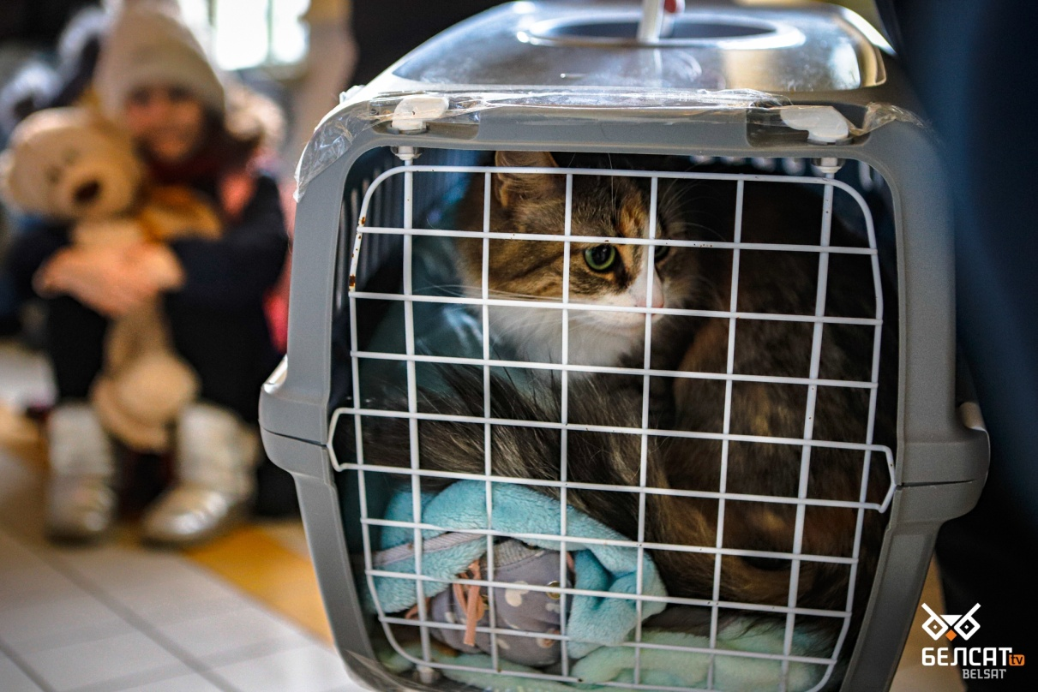
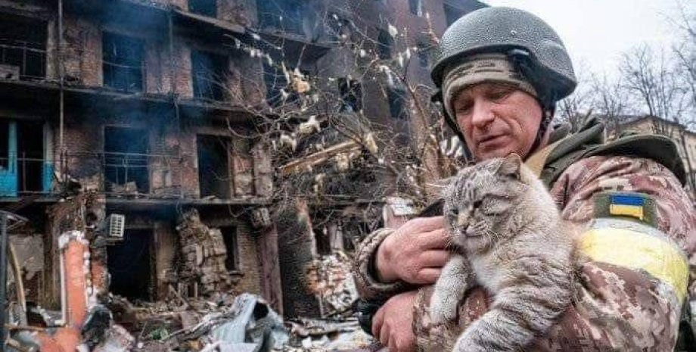
Notes:
Thousands of people left dangerous cities and relocated to other regions or abroad. Some of them took their pets with them, others abandoned them.

Slide 4
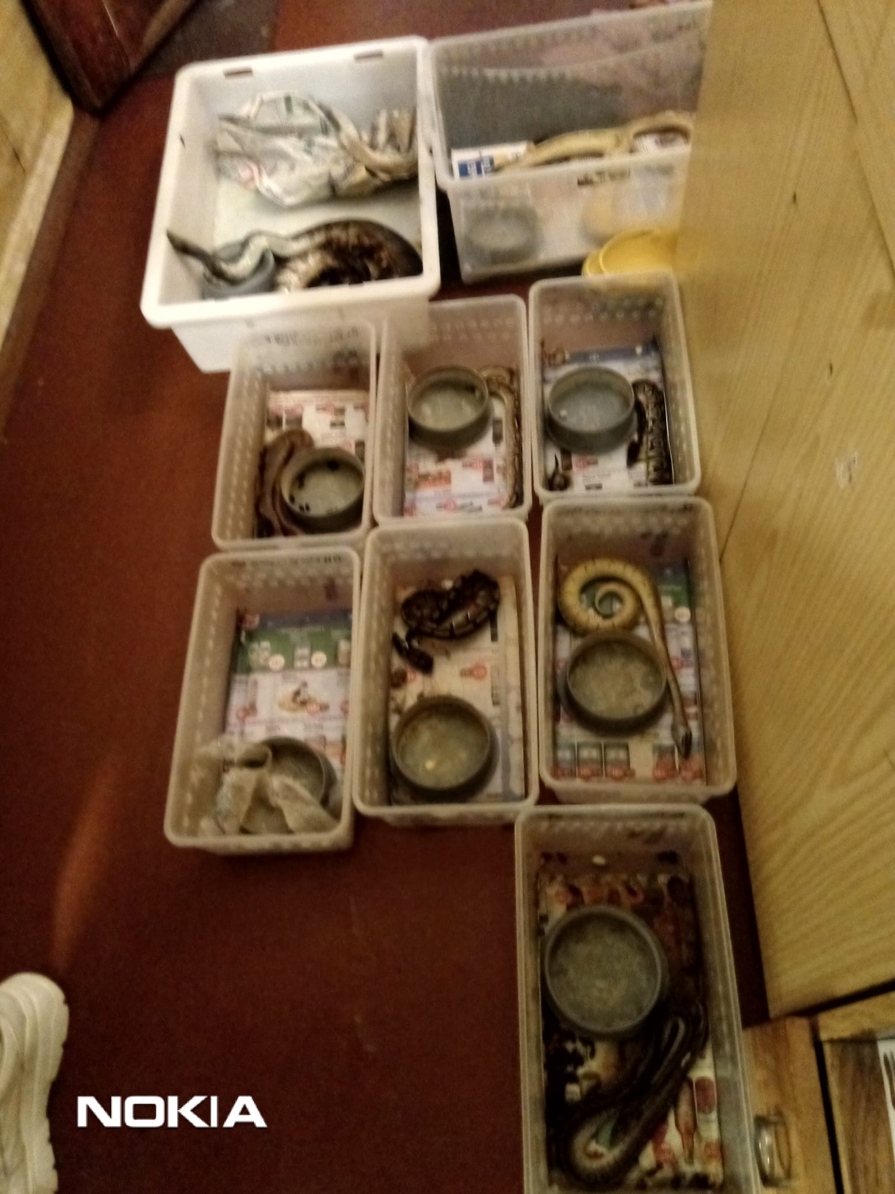
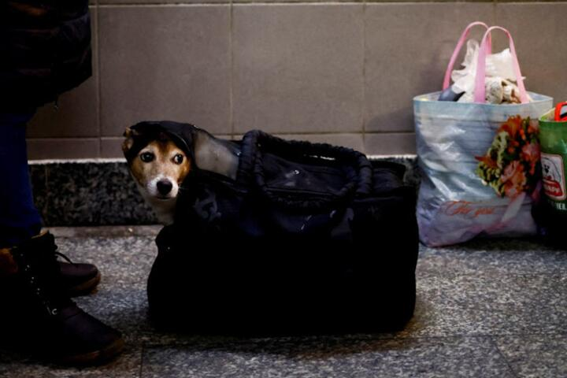
Problems Ukrainian animals face due to the war:
abandoned animals in dangerous places
and in closed flats
crossing borders and relocating with animals
Notes:
Thus we got first two problems: abandoned animals in dangerous places and closed flats, and challenges with crossing borders and relocating with animals.

Slide 5
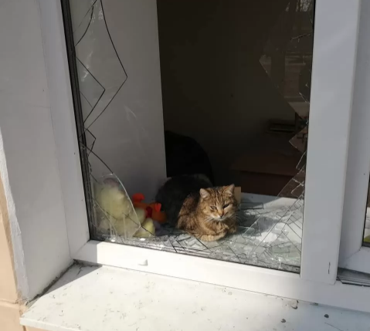
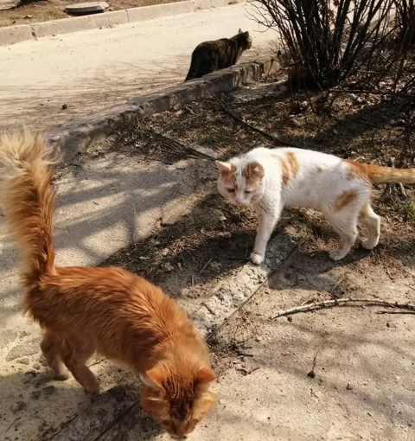
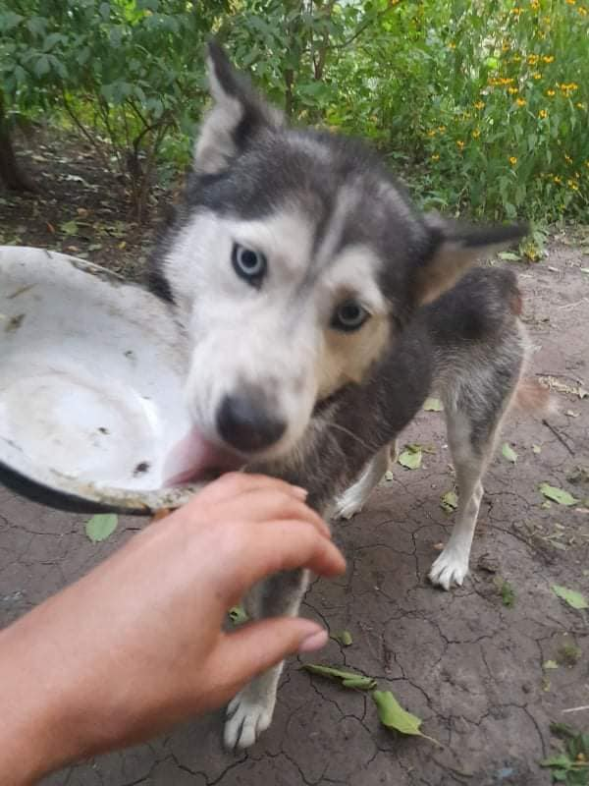
Problems Ukrainian animals face due to the war:
lack of food and medicines
Notes:
The people who stayed mostly remained without work, money and food for themselves and for their pets. Shops and pharamacies didn't work, it was dangerous to go anywhere to get food. Caring people had to feed more animals, shelters started to be overcrowded with new and new fosters.
This is how the third problem appeared: people and animals needed food and medicines

Slide 6
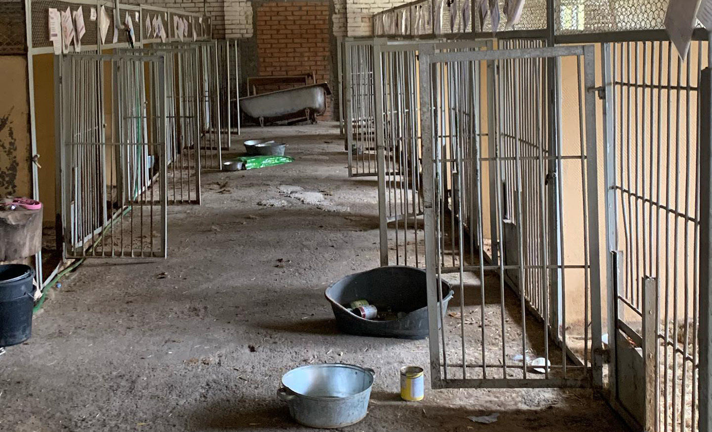
Problems Ukrainian animals face due to the war:
no opportunity to help occupied towns
animals breed uncontrollably
Notes:
Many Ukrainian towns and villages in Kharkiv, Kyiv, Chernihiv, Sumy regions became occupied. Local pet owners and animal activists remained without internet, mobile connection and ability to interact with other parts of Ukraine. Here the fourth problem appeared: no opportunity to bring aid where it is needed. Besides, as lots of abandoned and lost animals were not spayed and neutered they started breeding and the problem started to increase

Slide 7
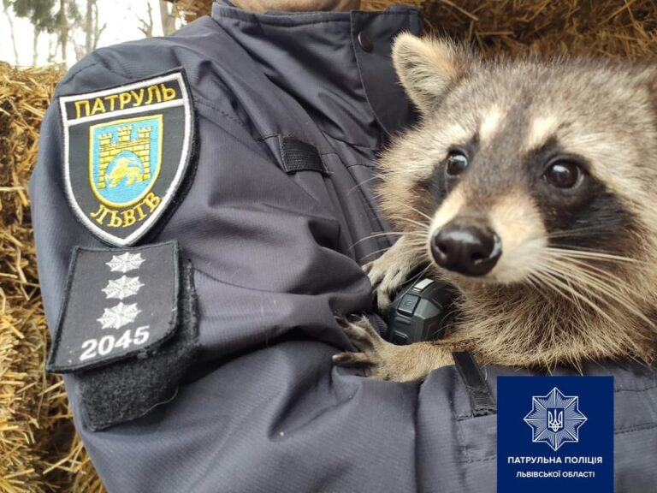
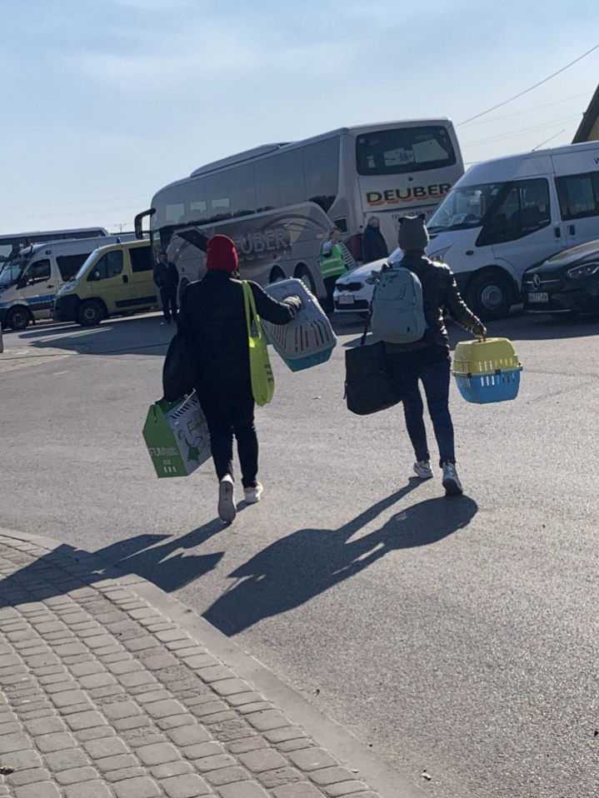
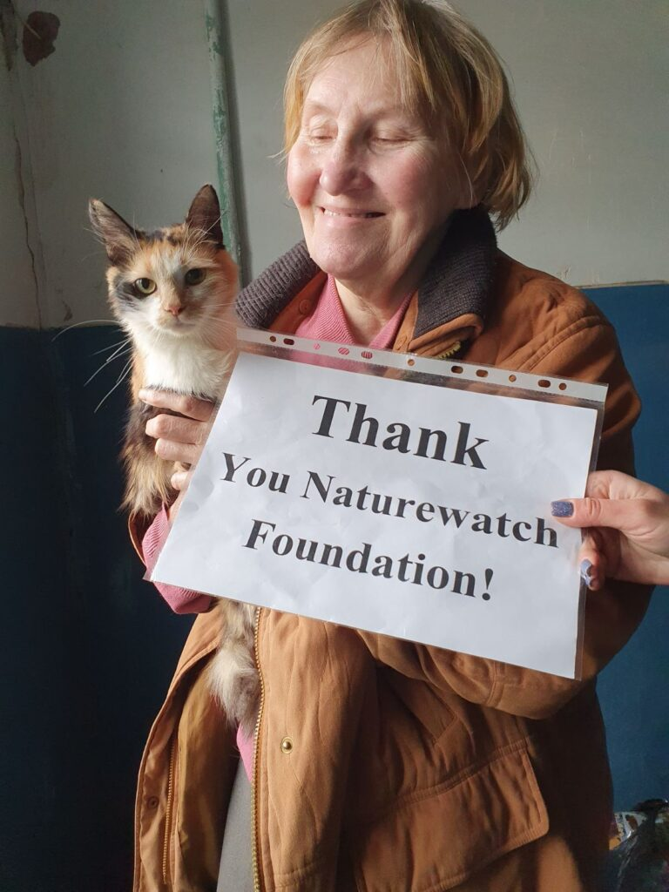
donating food and medicines;
helping refugees with animals
on the border with Poland;
setting stray animal feeding stations;
funding spay and neuter projects in
Kharkiv and occupied Kupyansk;
providing carriers, cages,
medicines, equipment and food
for shelters that accept
animals from war zone;
coordinating
international help;
training police
Notes:
Naturewatch Foundation has been working in Ukraine since 1994. With the start of war we have come up with different options to help. It included continuing our previous projects and starting several new ones. We actively cooperate with other organizations inside and outside Ukraine.

Slide 8
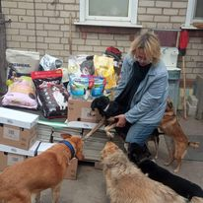
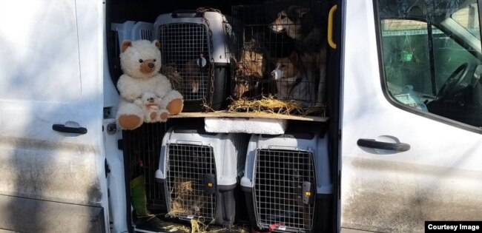
UPAW helps distributing
food to all over Ukraine
including occupied territories
Uanimals and
Kharkiv Animal
Rescue evacuate dogs, cats and other animals
to safer places including other countries
Notes:
Let me also tell you about other organization who help. I have been part of some of them, not all. But now it’s the time everybody joins forces

Slide 9
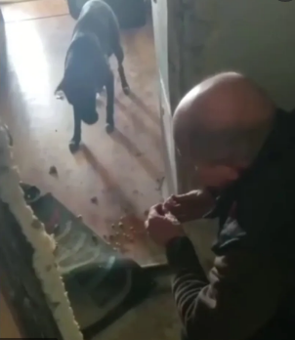
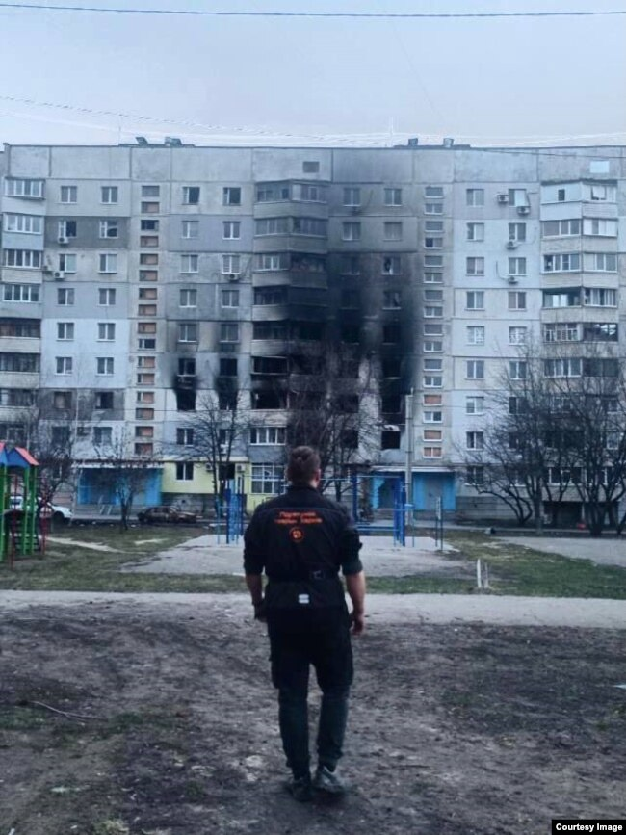
Kharkiv Animal
Rescue get abandoned animals
from closed flats

Slide 10
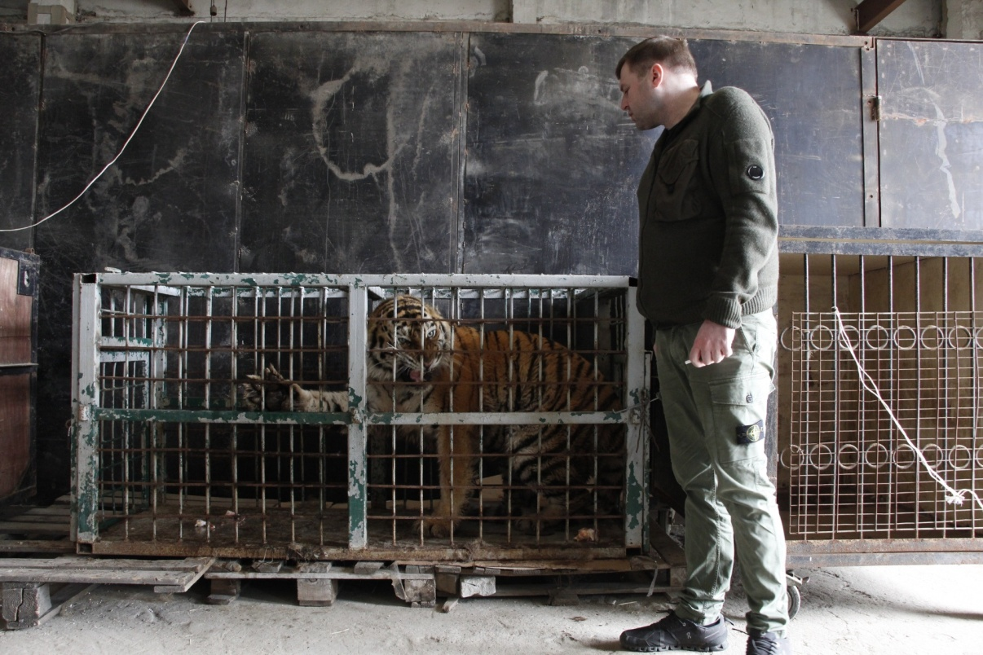
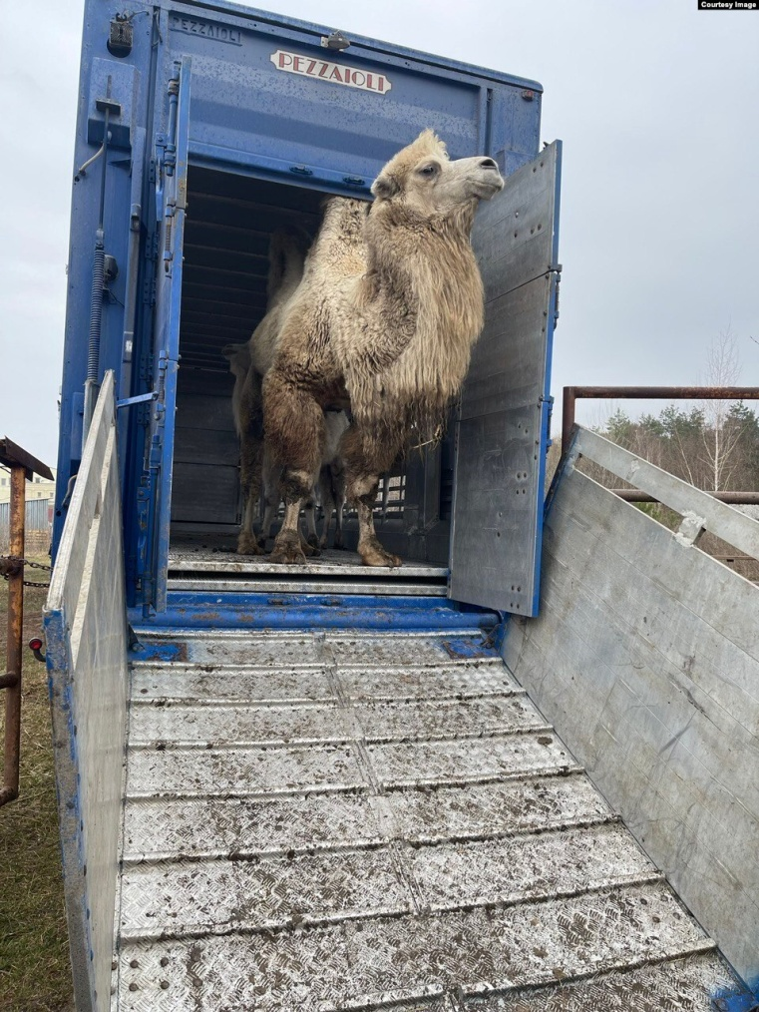
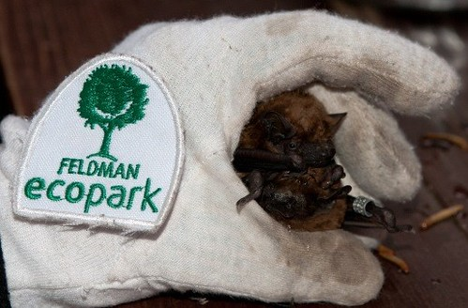
UAnimals, UAAA and
Bat Rehabilitation Center
evacuate and
care about wild animals
Notes:
Although most of the world is starting to get used to Ukrainian war and Ukraine is not in headlines as often, we don’t stop. The war doesn’t finish and more and more animals need our help. So please keep supporting Ukraine in helping animals.

Slide 11
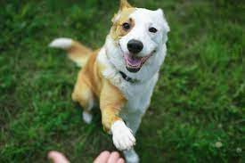
natalie@naturewatch.org
+380507785818
Notes:
Thank you for your attention. If you happen to have any questions, please contact me.

